Slide 1
Fall 2021 Course Evaluations
Open: Wednesday November 24, 10:00 AM
Close: Wednesday December 8, 11:59 PM evals.mcmaster.ca
#macevals2021

Slide 2
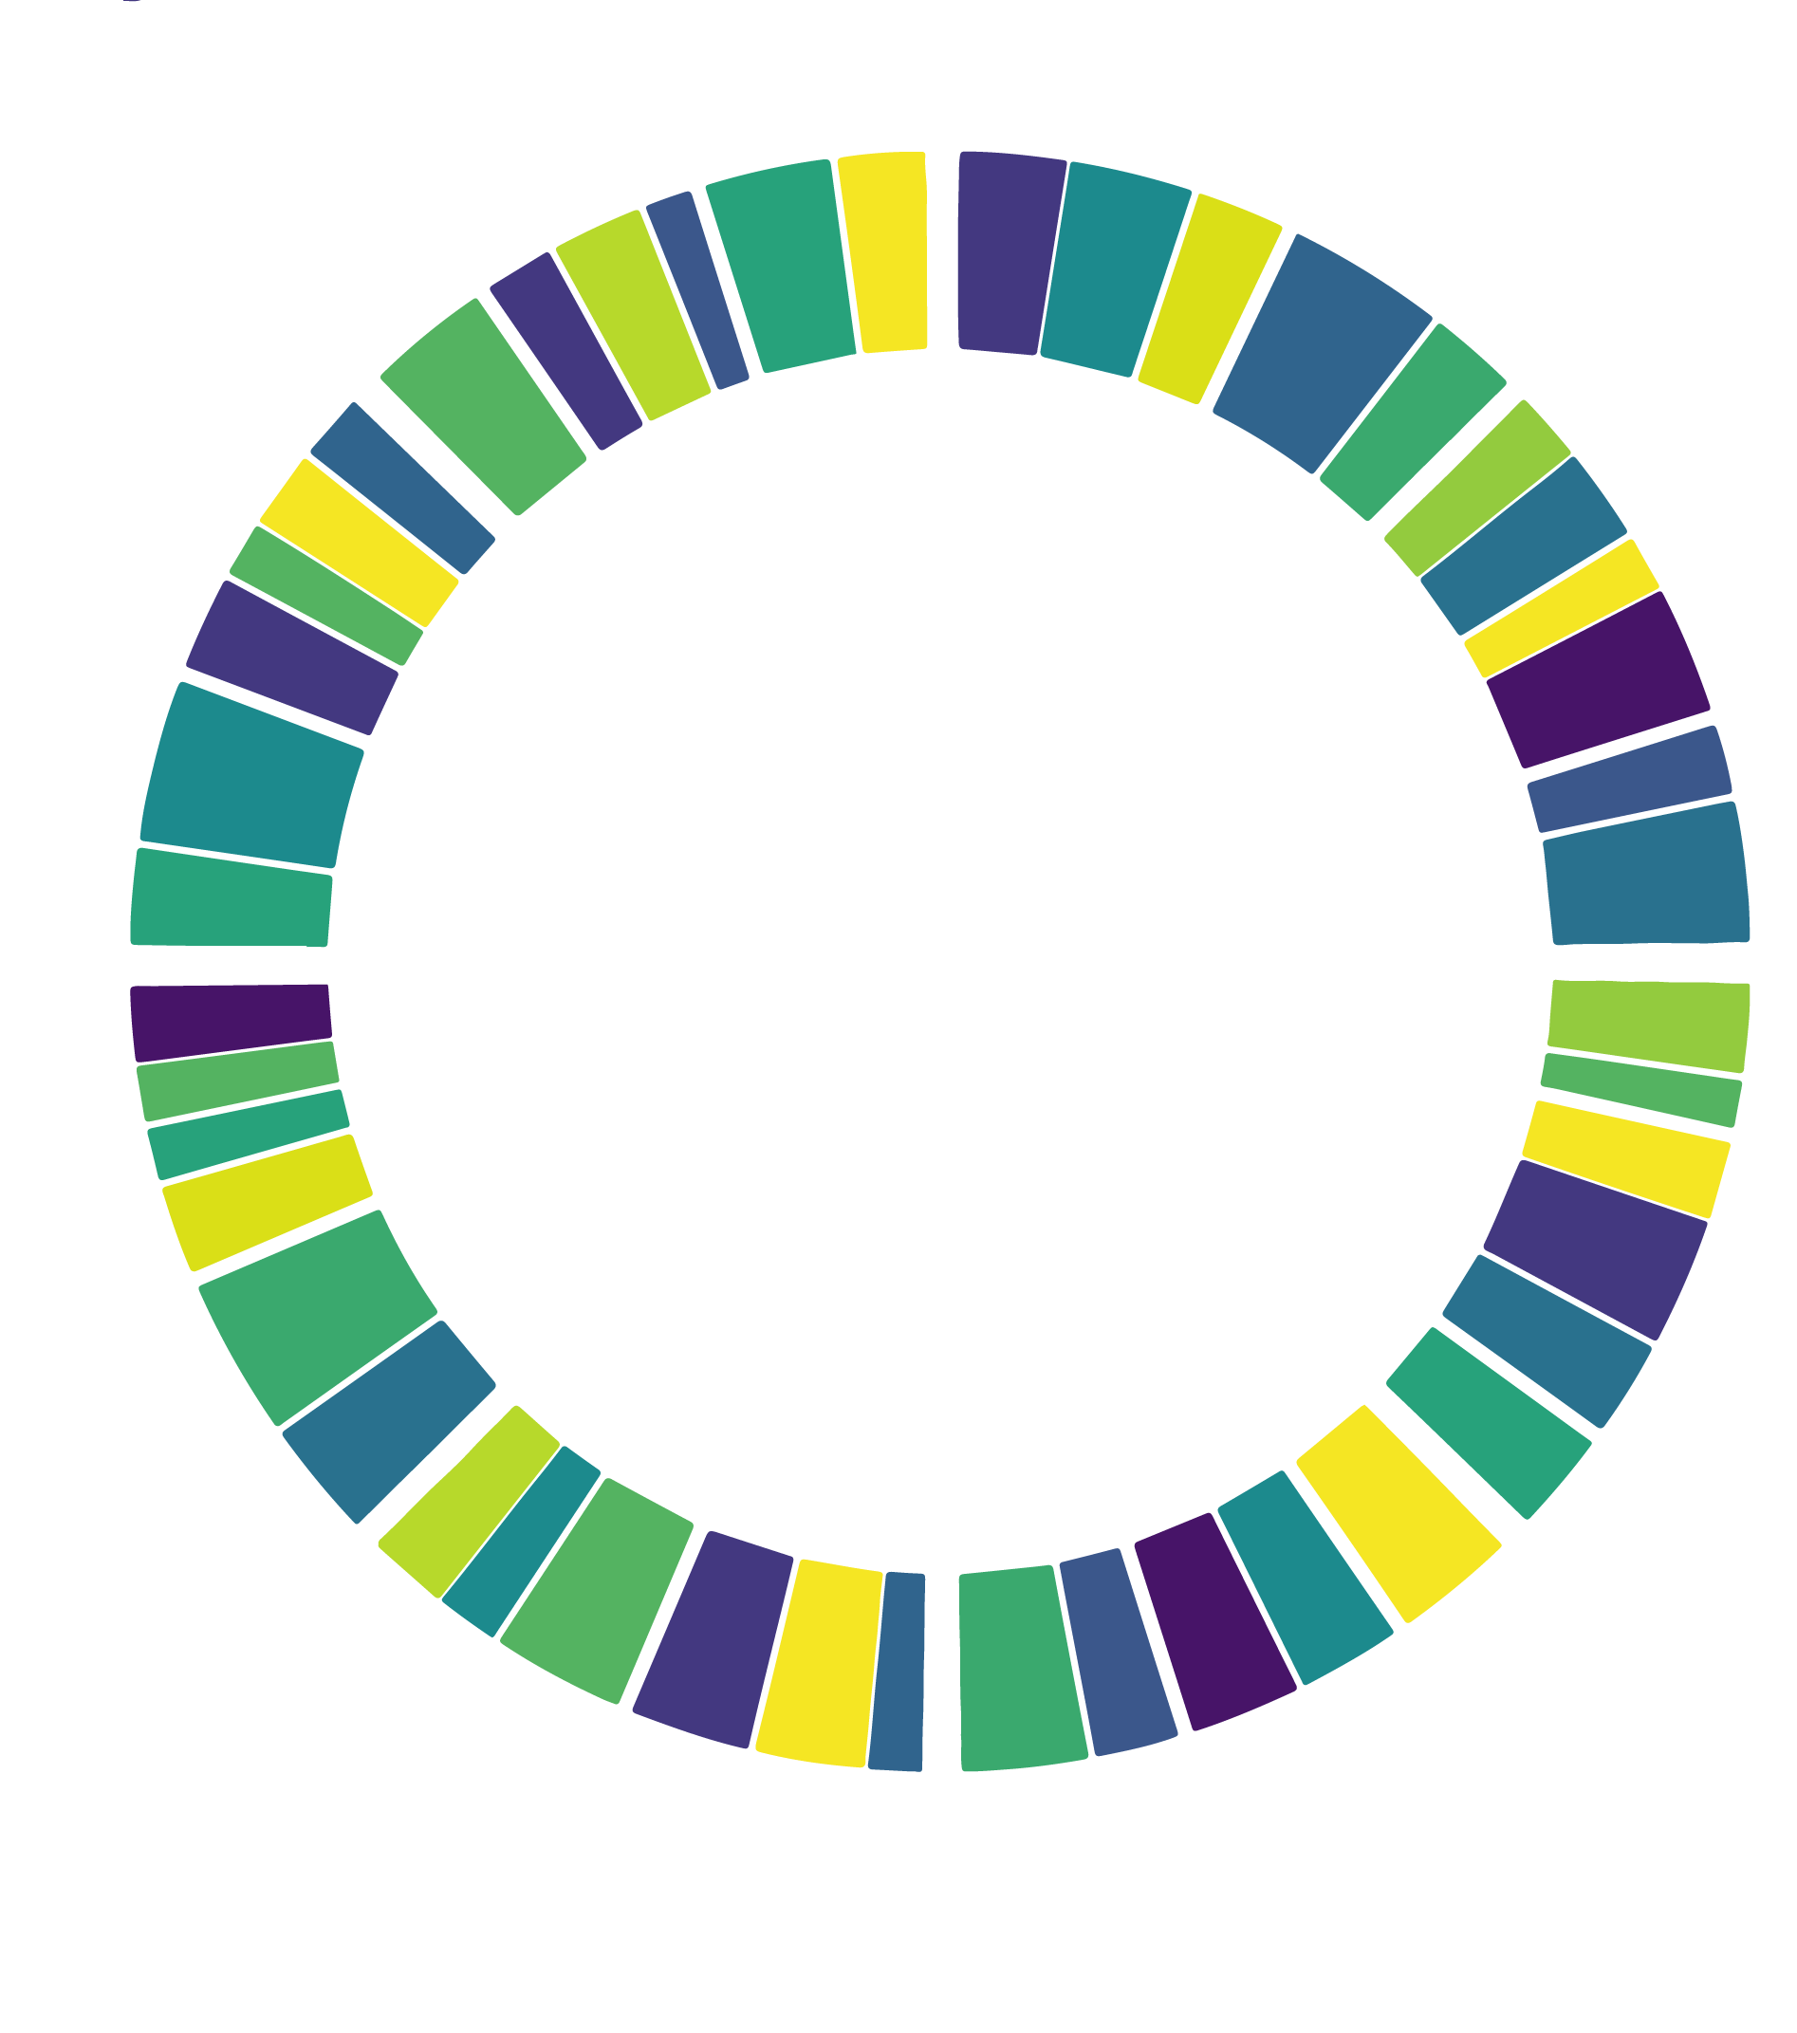
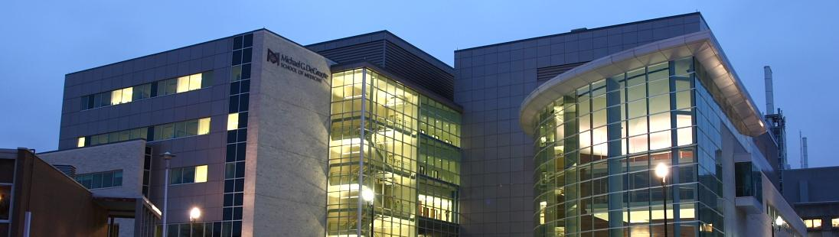
Continued Genomic epidemiology in the time of SARS-CoV-2
Jalees A. Nasir Adapted from slides by Dr. Andrew G. McArthur
Michael G. DeGroote Institute for Infectious Disease Research
David Braley Center for Antibiotic Discovery
Department of Biochemistry & Biomedical Sciences
McMaster University, Canada
mcarthurbioinformatics.ca I oncov.ca I iidr.mcmaster.ca

Slide 3




Slide 4
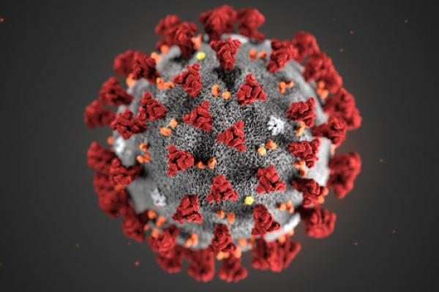
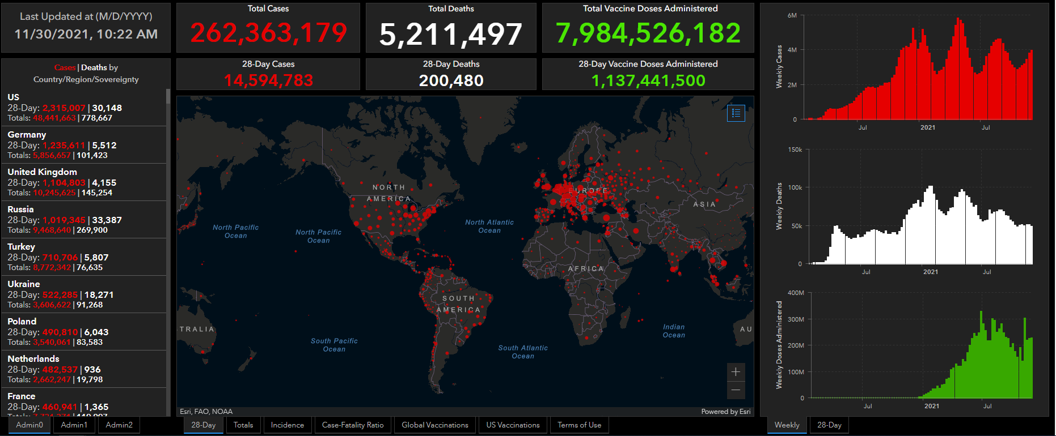
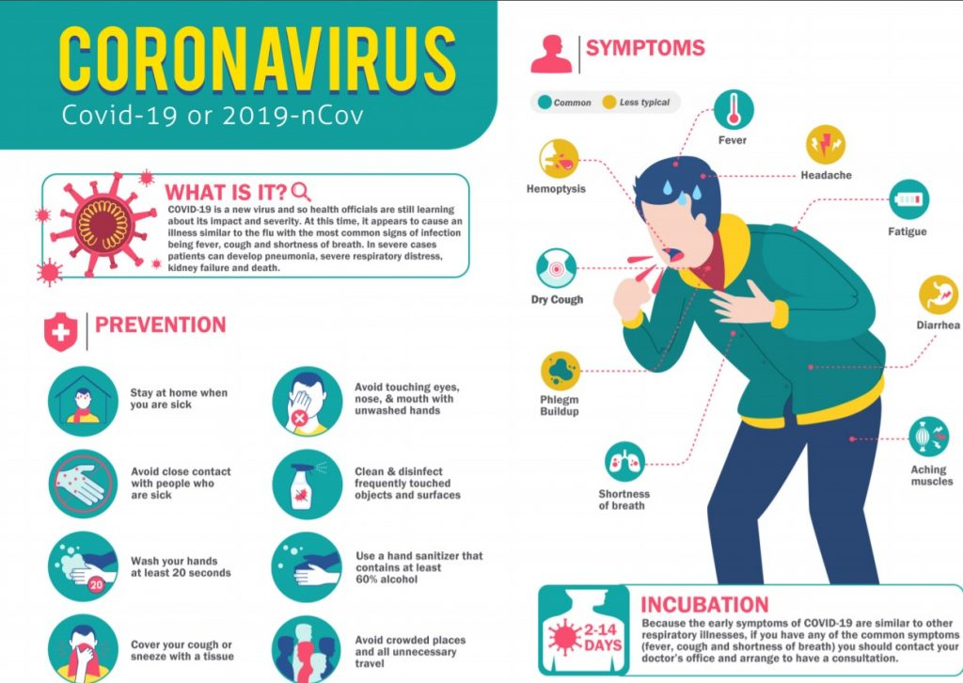
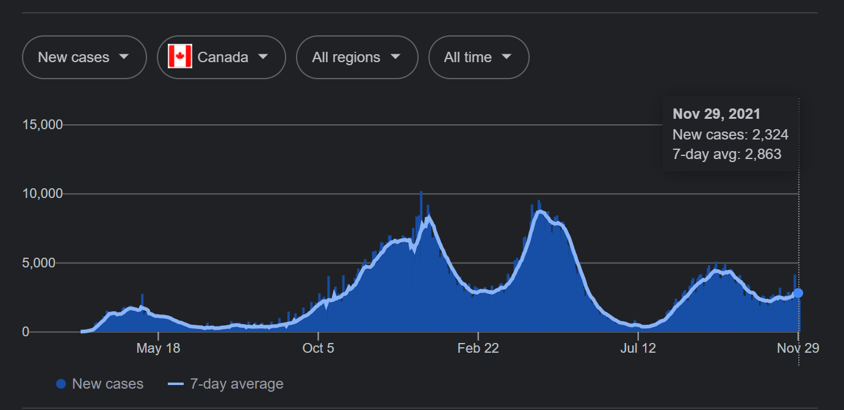
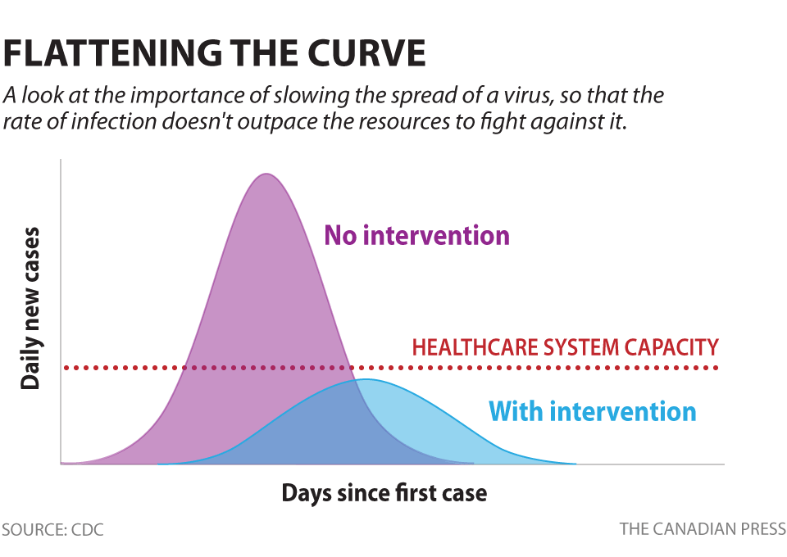
SARS-CoV-2

Slide 5


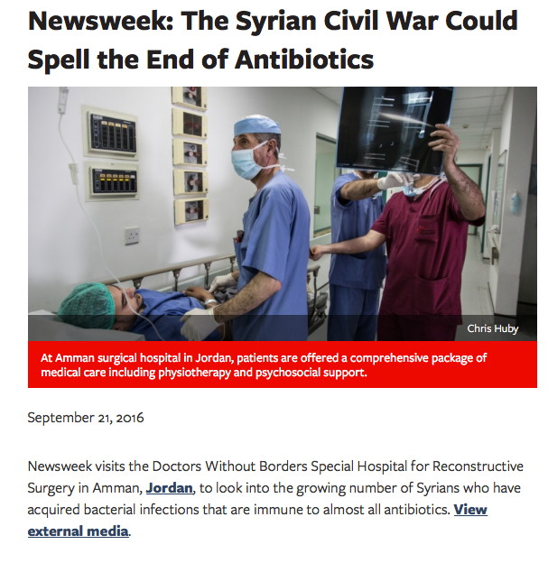


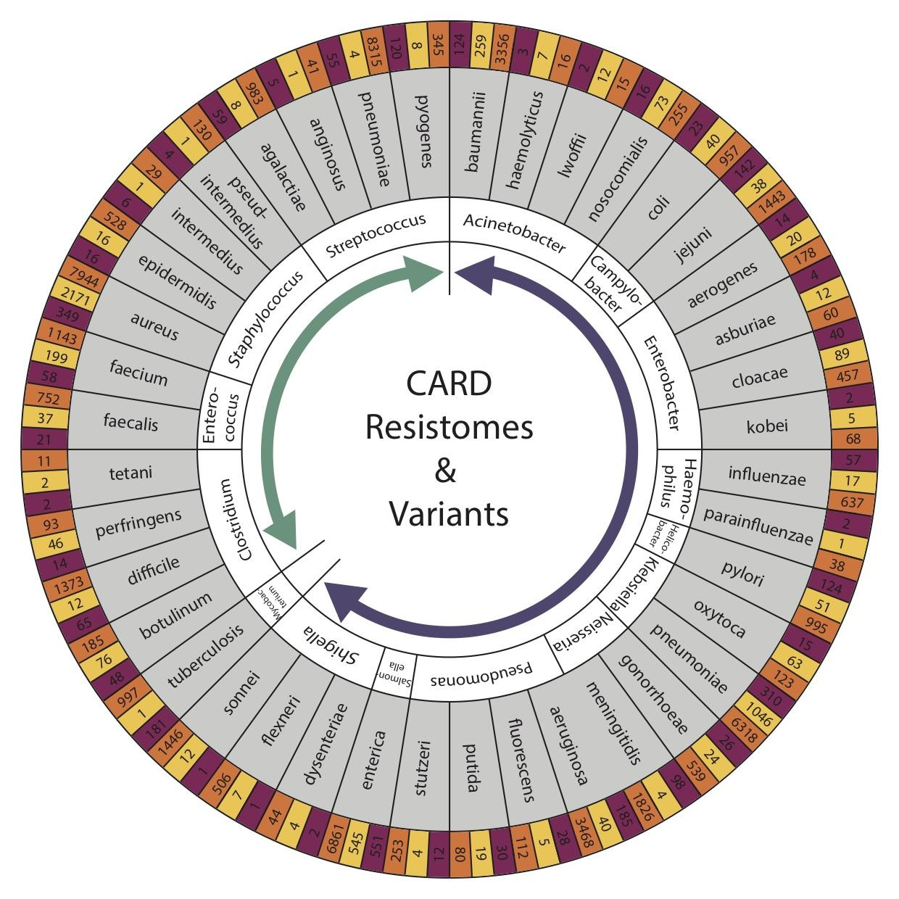


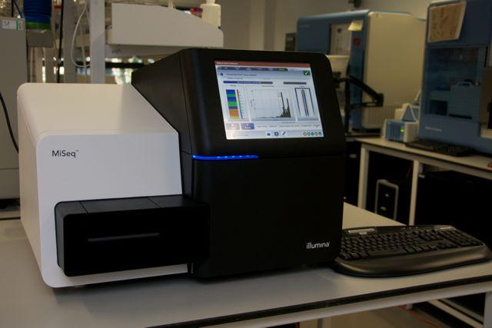
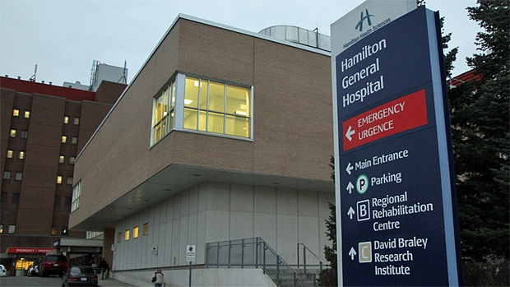

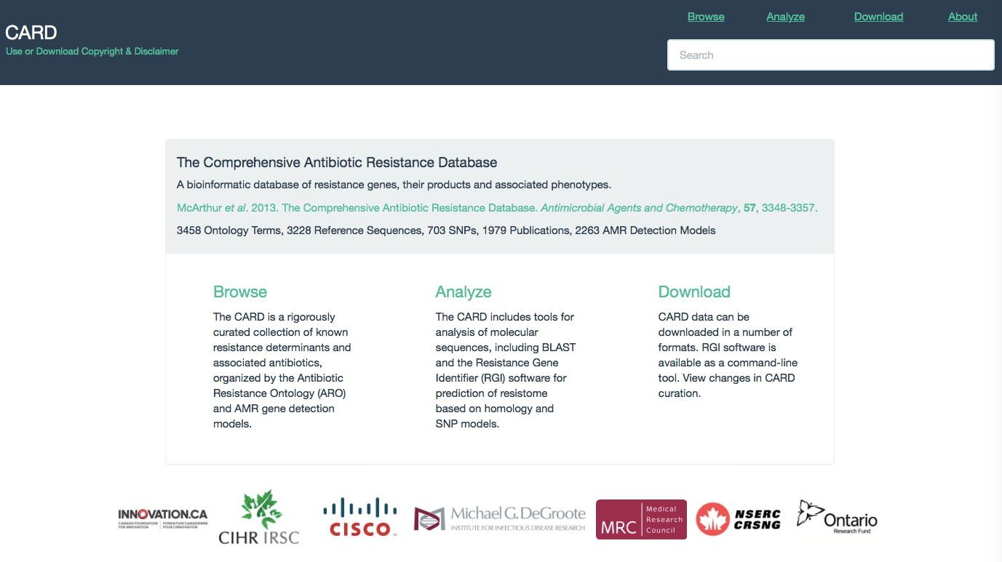
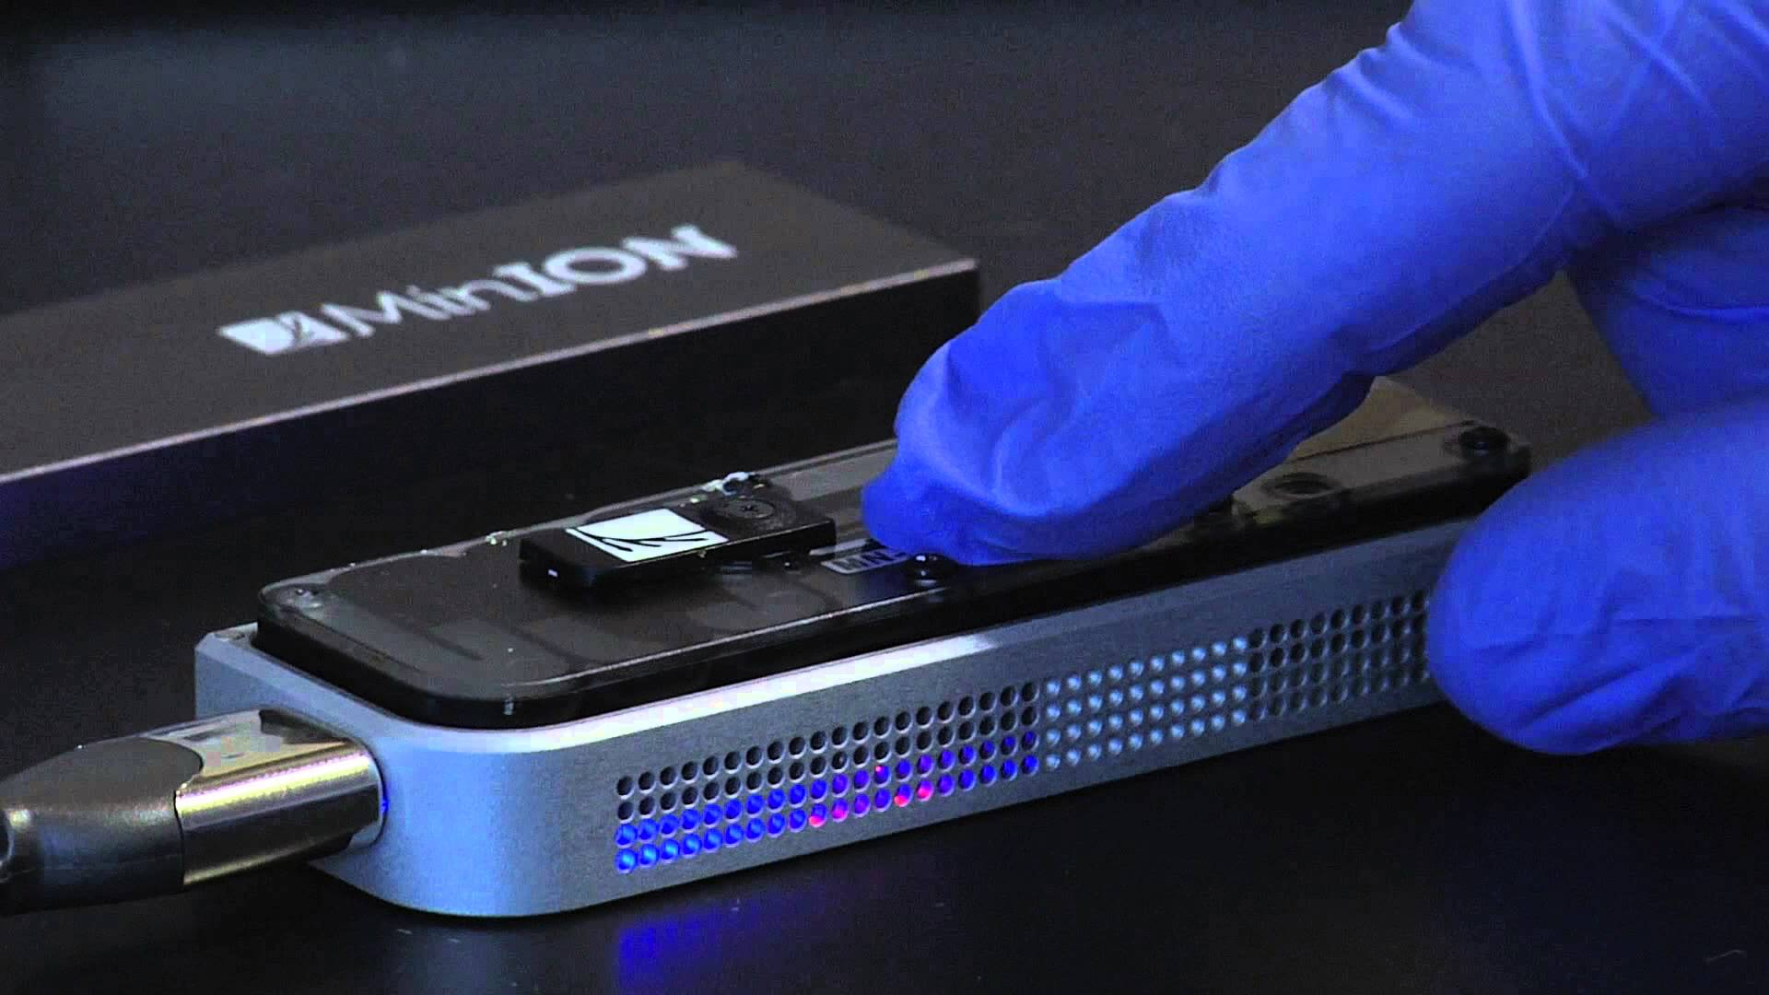
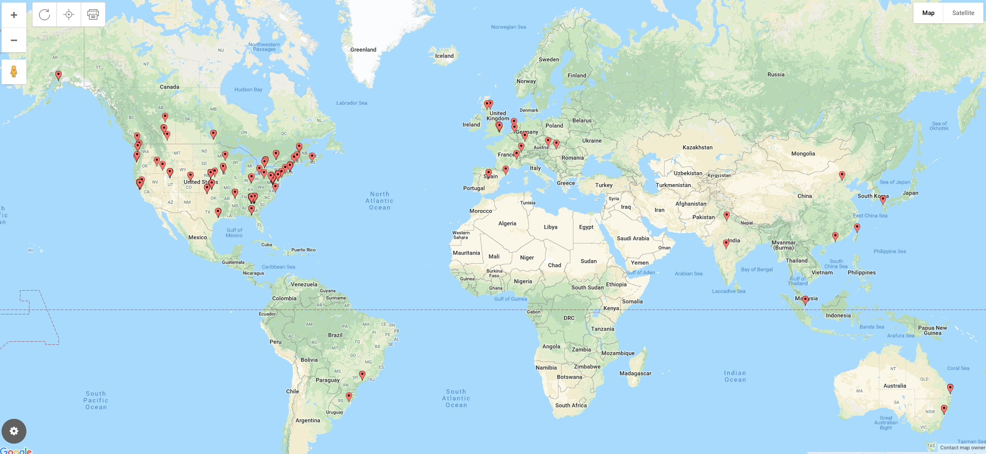
Antimicrobial Resistance
Analytics
Bioinformatics
DNA Sequencing
Biocuration
Public Health Agency Usage 2019
DETECT
DECODE
DEPLOY
patient
community
national & international
diagnostics
outbreaks
surveillance

Slide 6

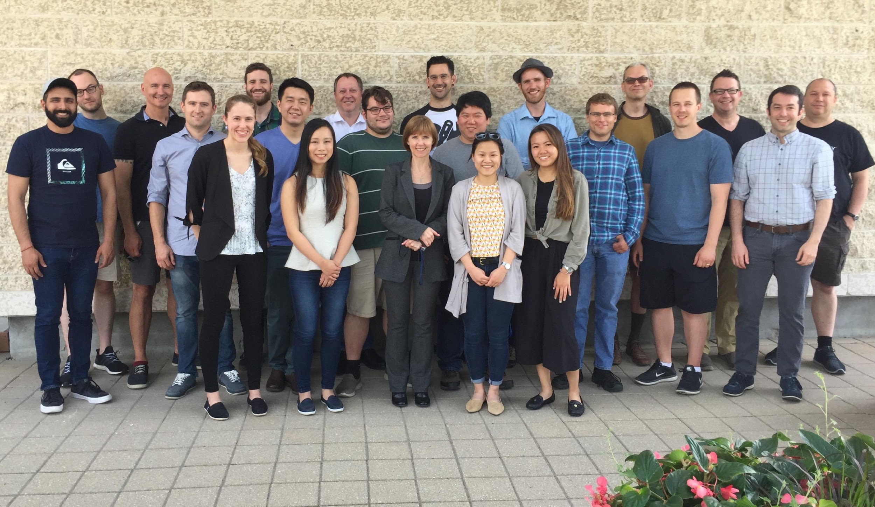

Integrated Rapid Infectious Disease Analysis (IRIDA) Platform - a Canadian-led open source, end-to-end platform for public health genomics

Slide 7
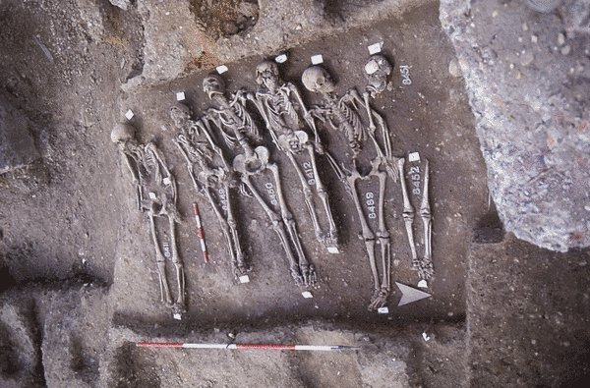
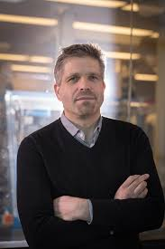
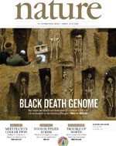

Integrated Rapid Infectious Disease Analysis (IRIDA) Platform - a Canadian-led open source, end-to-end platform for public health genomics
Hendrick Poinar

Slide 8
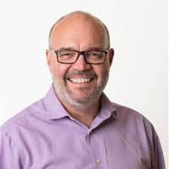
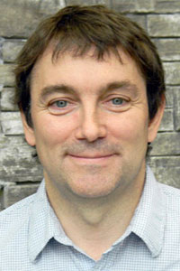
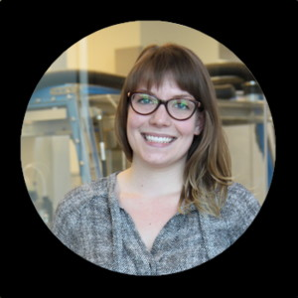
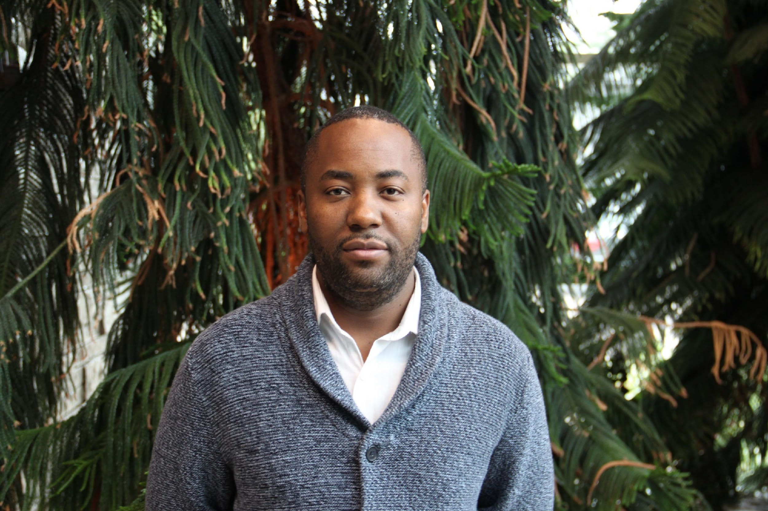
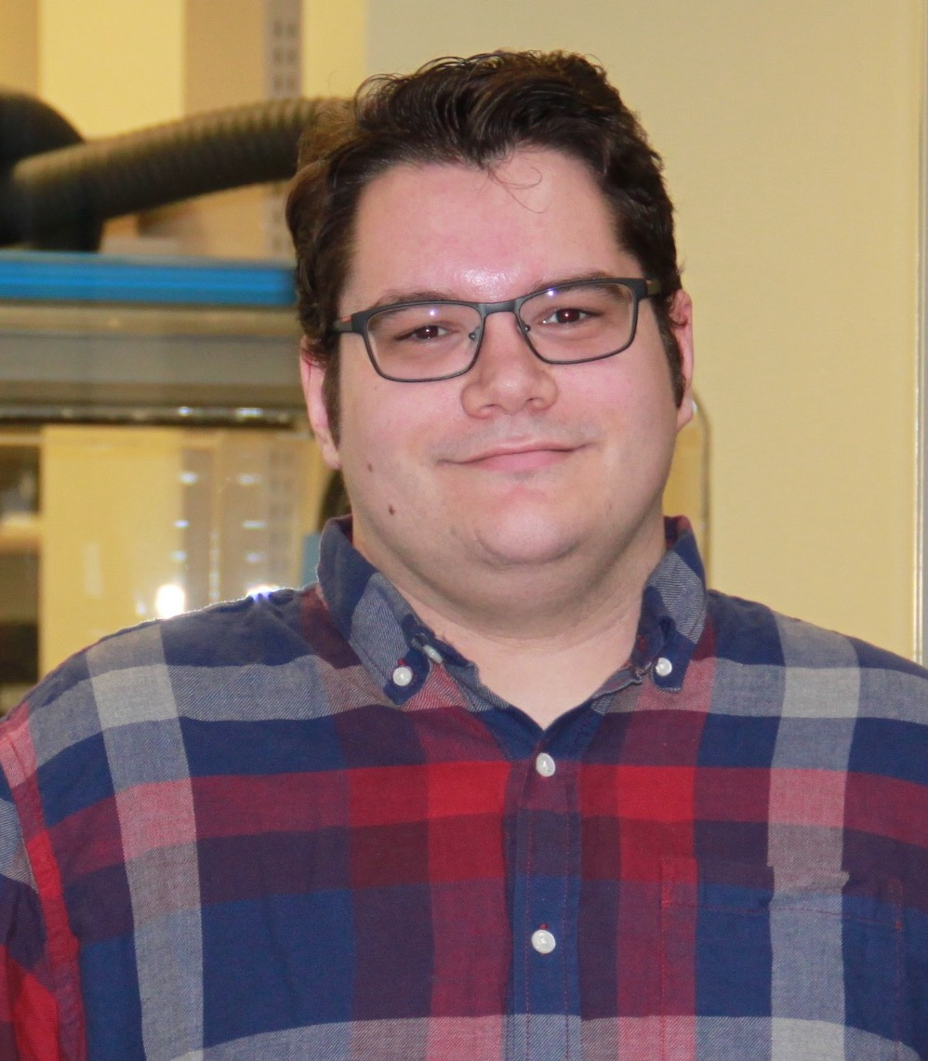
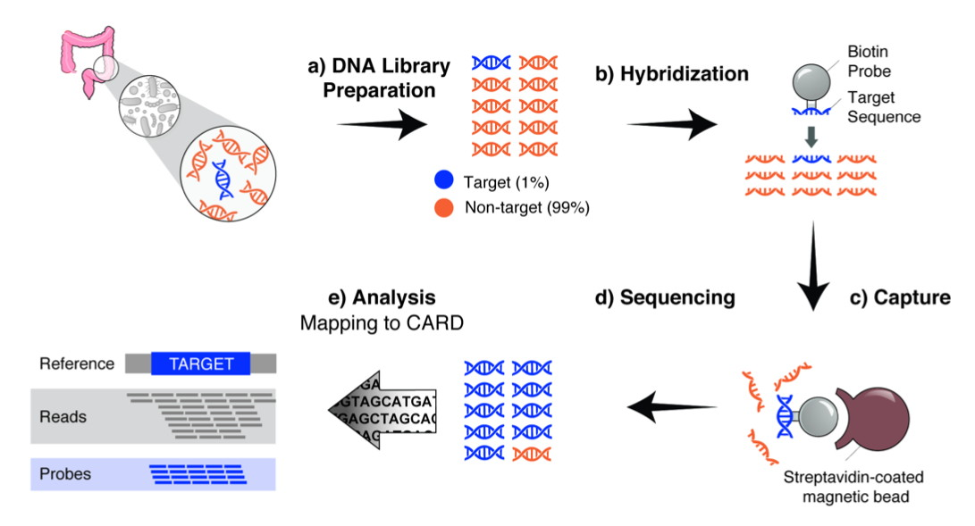
AMR Bait Capture
Allison Guitor, Ph.D. student
(Wright Lab)
Amos Raphenya
Lead CARD Developer
Brian Alcock
Lead CARD Curator
Hendrick Poinar
Gerry Wright
Mike Surette
Guitor et al. 2019. Antimicrobial Agents and Chemotherapy, 64, e01324-19.

Slide 9
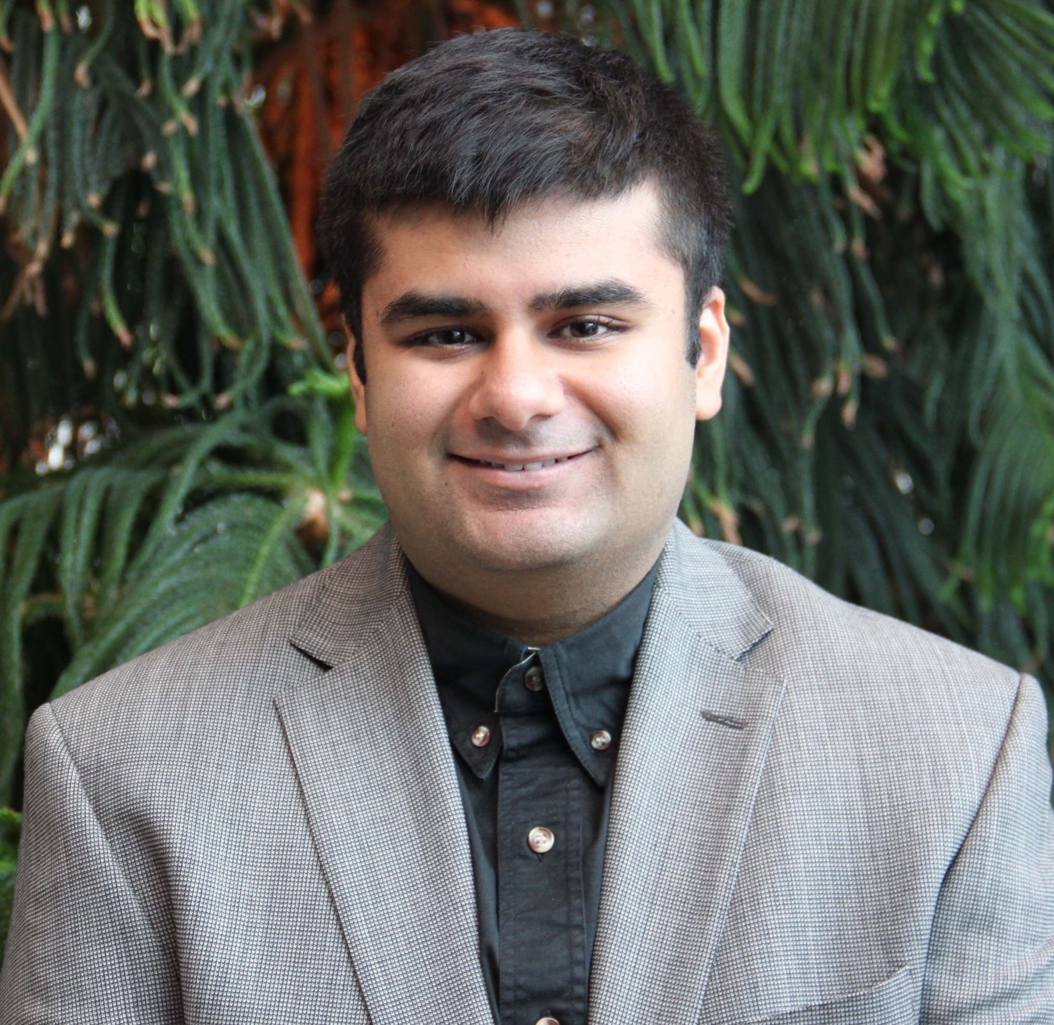
Summer 2019 – Viral Bait Capture
3 million available virus sequences
Existing design methods would result in over 85,000,000 hybridization baits
Hendrick Poinar
Jalees Nasir, PhD Student (McArthur Lab)

Slide 10
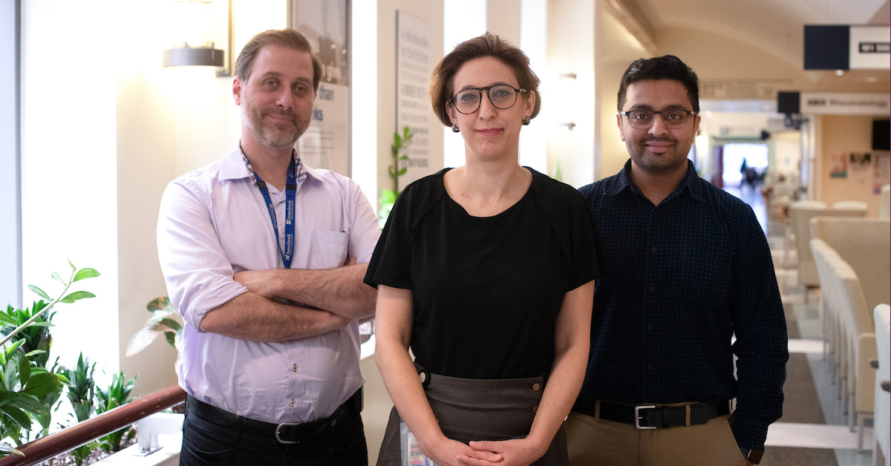
Summer 2019 – Viral Bait Capture
3 million available virus sequences
Existing design methods would result in over 85,000,000 hybridization baits
Hendrick Poinar
Jalees Nasir, PhD Student (McArthur Lab)
Syndromic bait sets
Focus on respiratory viruses first
30% are lacking diagnostic tools
Include seasonal and other coronaviruses
Robert Kozak, Samira Mubareka (Sunnybrook Health Sciences)

Slide 11
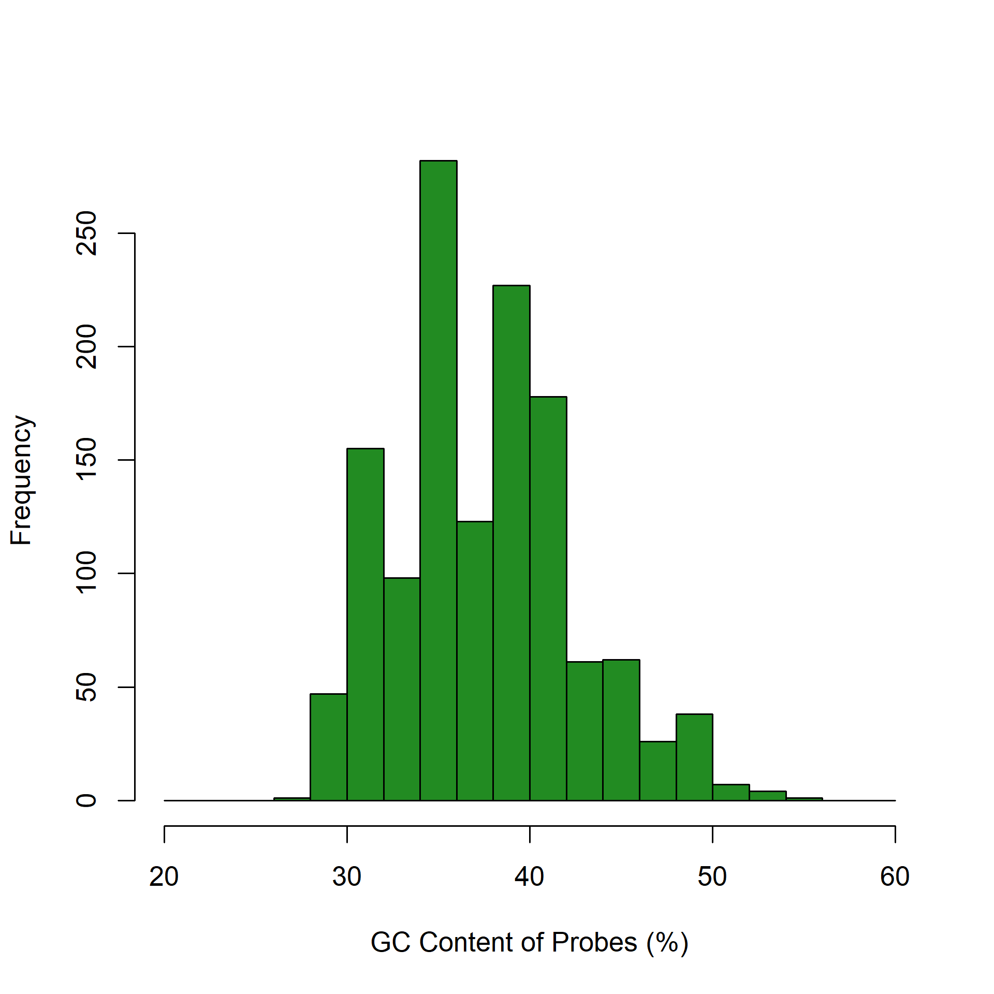
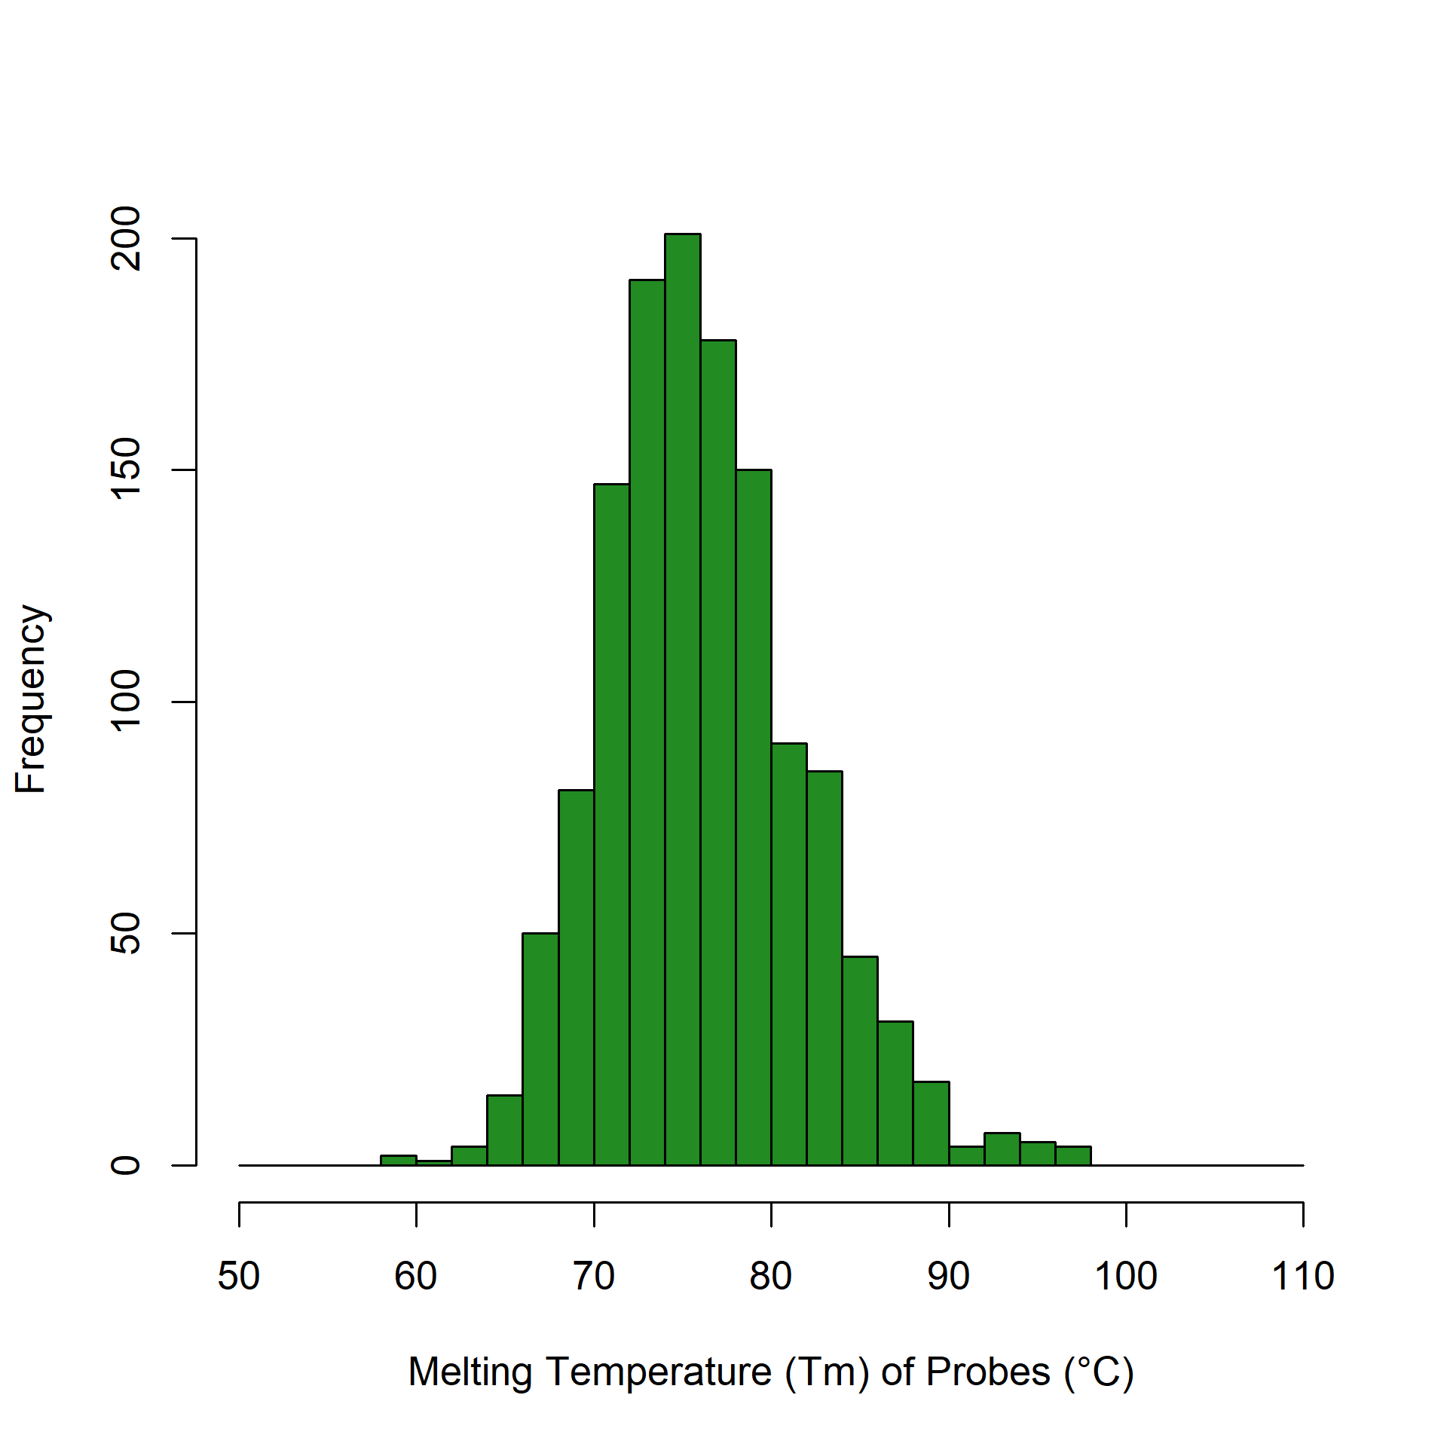
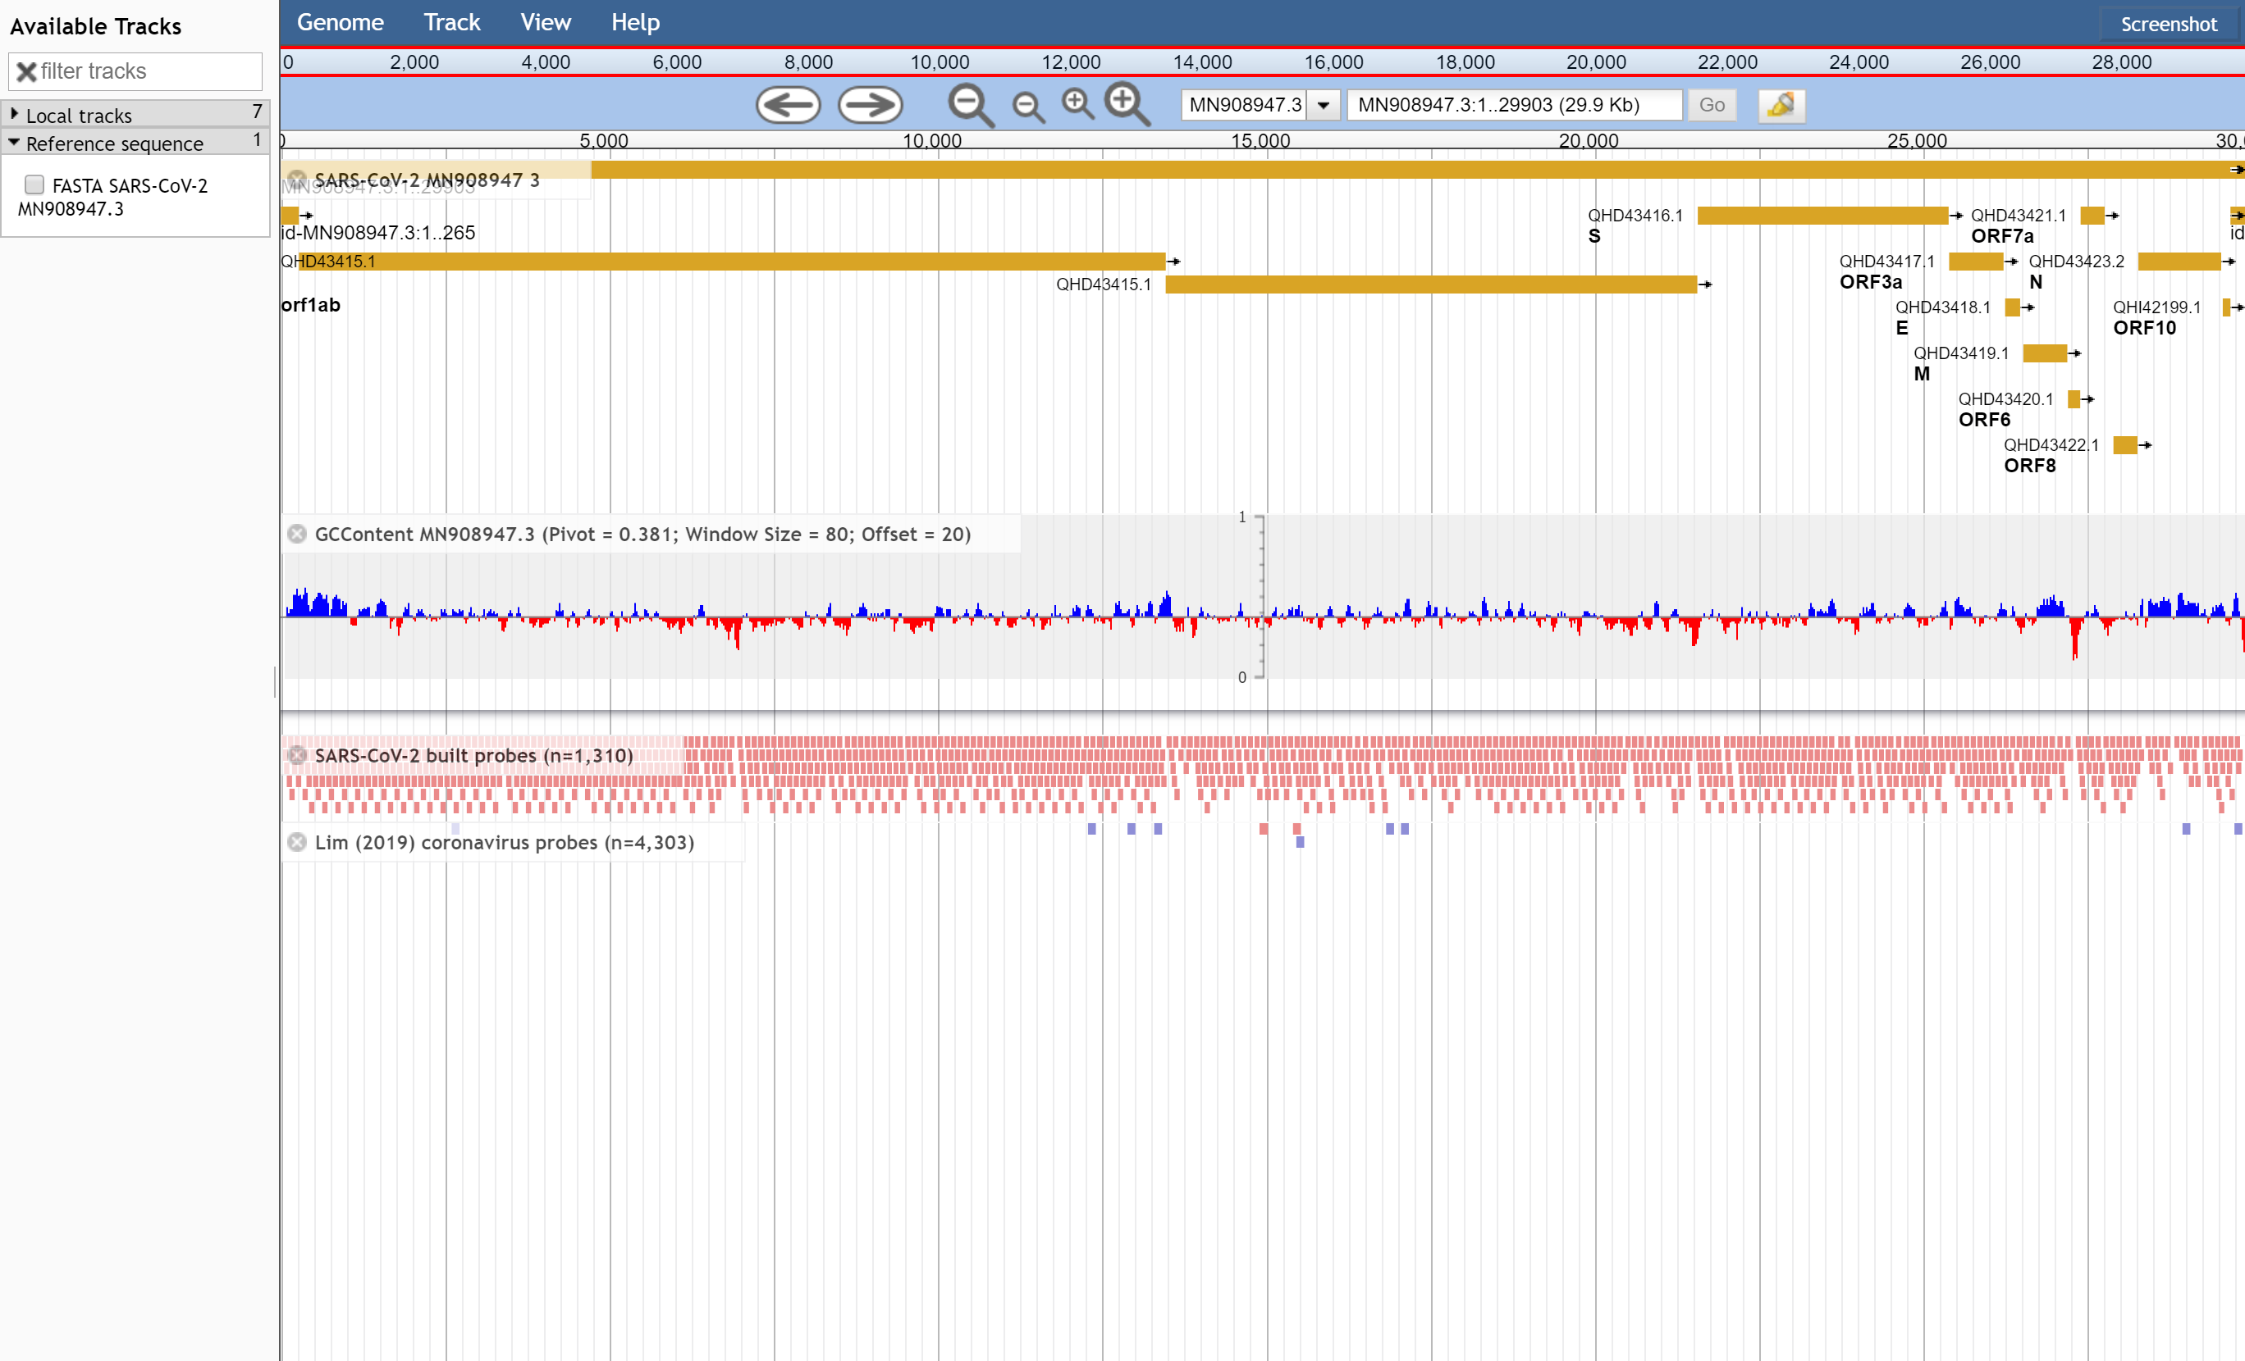
Winter 2020 – SARS-CoV-2 Bait Capture
SARS-CoV-2 Bait Capture Probe Set
https://github.com/jaleezyy/covid-19-baits
Nasir, J.A., D.J. Speicher, R.A. Kozak, H.N. Poinar, M.S. Miller, & A.G. McArthur. 2020. Rapid design of a bait capture platform for culture- and amplification-free next-generation sequencing of SARS-CoV-2. Preprints 2020, 2020020385.
Jalees Nasir, PhD Student (McArthur Lab)

Slide 12
Winter 2020 – SARS-CoV-2 Bait Capture
SARS-CoV-2 Bait Capture Probe Set
https://github.com/jaleezyy/covid-19-baits
Nasir, J.A., D.J. Speicher, R.A. Kozak, H.N. Poinar, M.S. Miller, & A.G. McArthur. 2020. Rapid design of a bait capture platform for culture- and amplification-free next-generation sequencing of SARS-CoV-2. Preprints 2020, 2020020385.
Jalees Nasir, PhD Student (McArthur Lab)

Slide 13
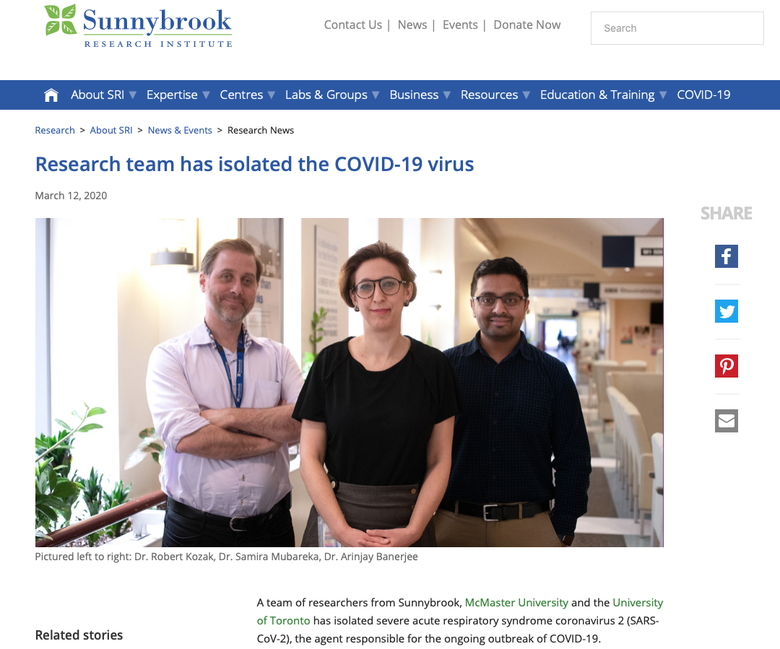
Banerjee et al. 2020. Isolation, sequence, infectivity and replication kinetics of SARS-CoV-2. Emerging Infectious Diseases, 26, 2054-2063.
Notes:
=

Slide 14
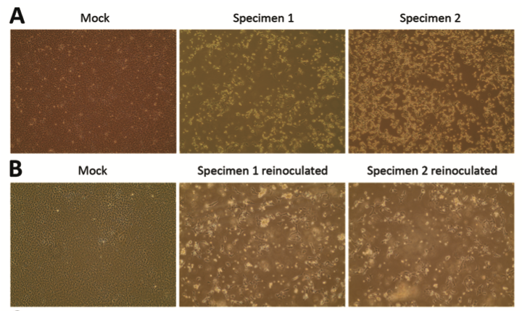
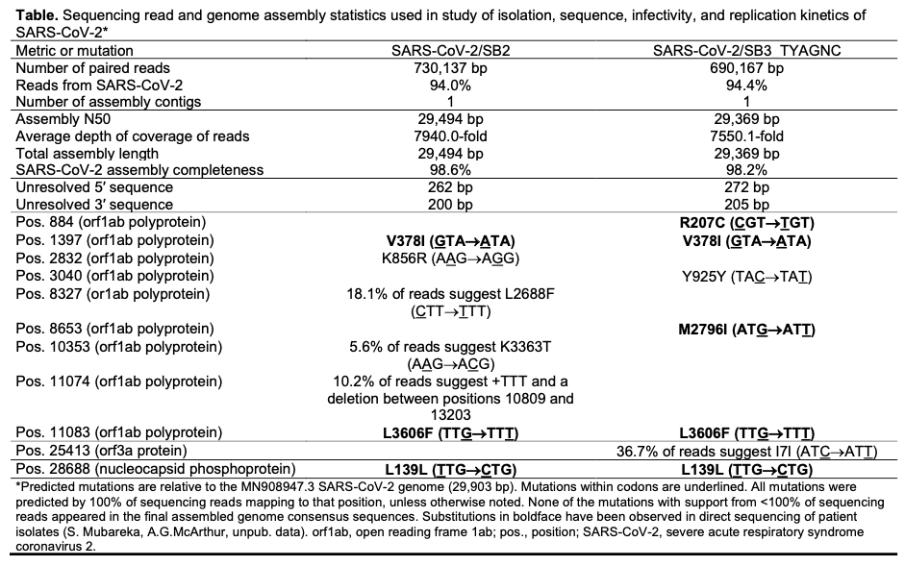
Banerjee et al. 2020. Isolation, sequence, infectivity and replication kinetics of SARS-CoV-2. Emerging Infectious Diseases, 26, 2054-2063.

Slide 15


Slide 16
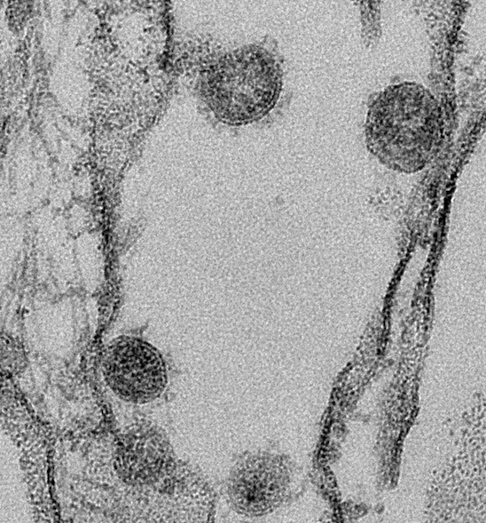
Why sequence SARS-CoV-2?
Validation of in vitro experiments
Image courtesy of Arinjay Banerjee
Notes:
=

Slide 17
Why sequence SARS-CoV-2?
Validation of in vitro experiments
Diagnostic escape
Vaccine escape
Image courtesy of Arinjay Banerjee

Slide 18
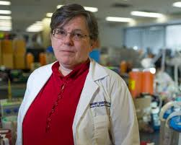
Why sequence SARS-CoV-2?
Validation of in vitro experiments
Diagnostic escape
Vaccine escape
Changing biology – infectivity, virulence
Re-infection & immunity
Environmental transmission
Image courtesy of Arinjay Banerjee
Allison McGeer - Mount Sinai Hospital

Slide 19
Why sequence SARS-CoV-2?
Validation of in vitro experiments
Diagnostic escape
Vaccine escape
Changing biology – infectivity, virulence
Re-infection & immunity
Environmental transmission
Global and community transmission
Outbreak dynamics
Image courtesy of Arinjay Banerjee
Allison McGeer - Mount Sinai Hospital

Slide 20
Why sequence SARS-CoV-2?
Validation of in vitro experiments
Diagnostic escape
Vaccine escape
Changing biology – infectivity, virulence
Re-infection & immunity
Environmental transmission
Global and community transmission
Outbreak dynamics
Image courtesy of Arinjay Banerjee
Allison McGeer - Mount Sinai Hospital

Slide 21
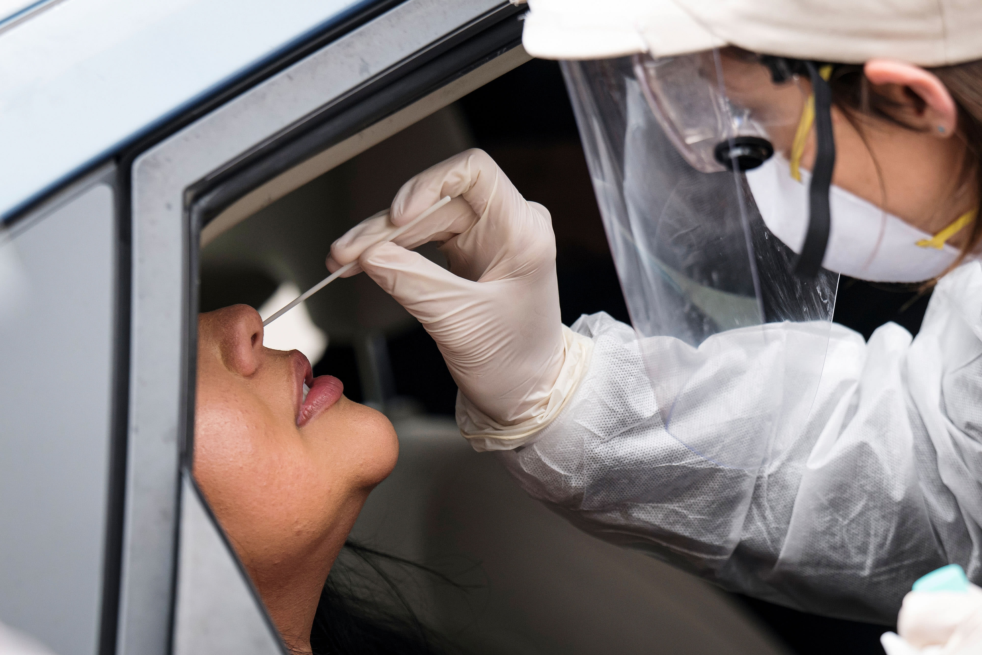
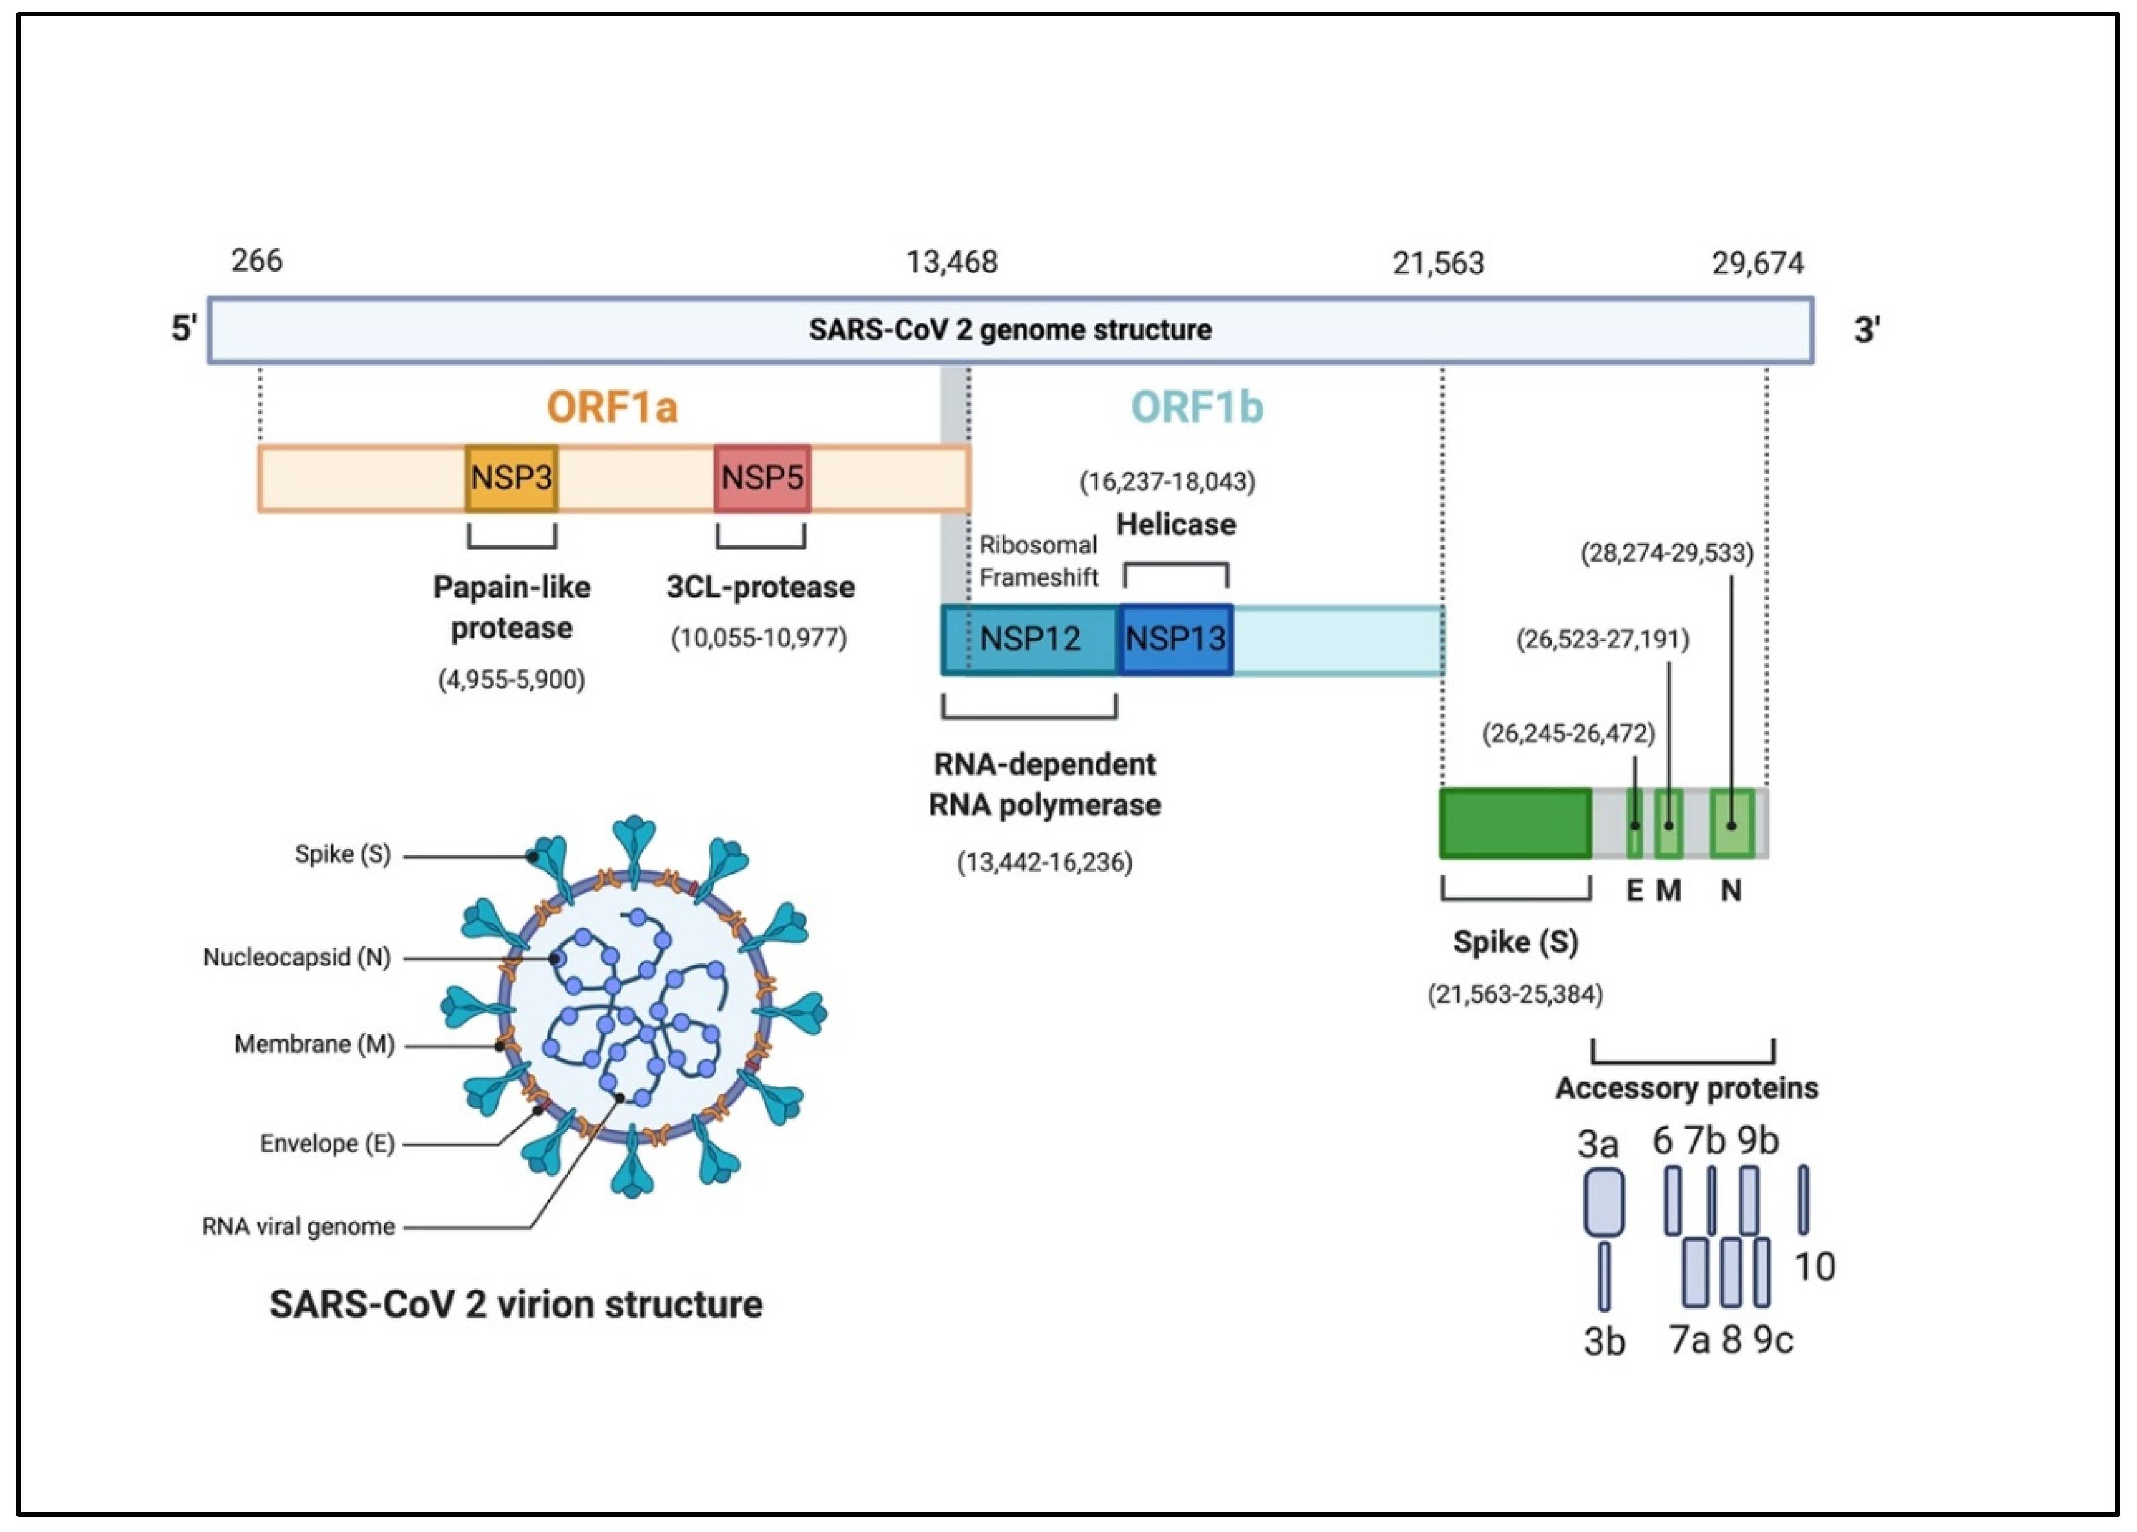
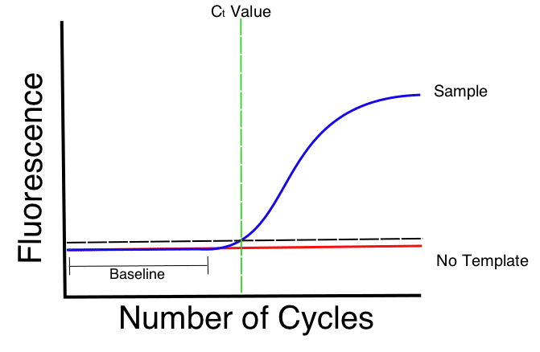
Diagnostic Escape Mutations
SeeGene; Assay: Allplex COVID assay - can detect 3 different genes - RdRp, Envelope and Nucleocapsid
Roche; Assay: Cobas SARS-CoV-2 assay - can detect 2 genes, ORF1ab gene (Target 1) and Envelope gene (Target 2)
Altona Diagnostics; Assay: RealStar SARS-CoV-2 assay - can detect the Spike and Envelope gene
BGI Genomics; MGI SARS-CoV-2 Assay – detects the ORF1ab gene
Hamilton Regional Laboratory Medicine Program; Assay: SARS-CoV-2 – detects 2-3 different viral genes
Public Health Ontario Laboratory; Assay: SARS-CoV-2 – detects 2 different viral gene targets

Slide 22
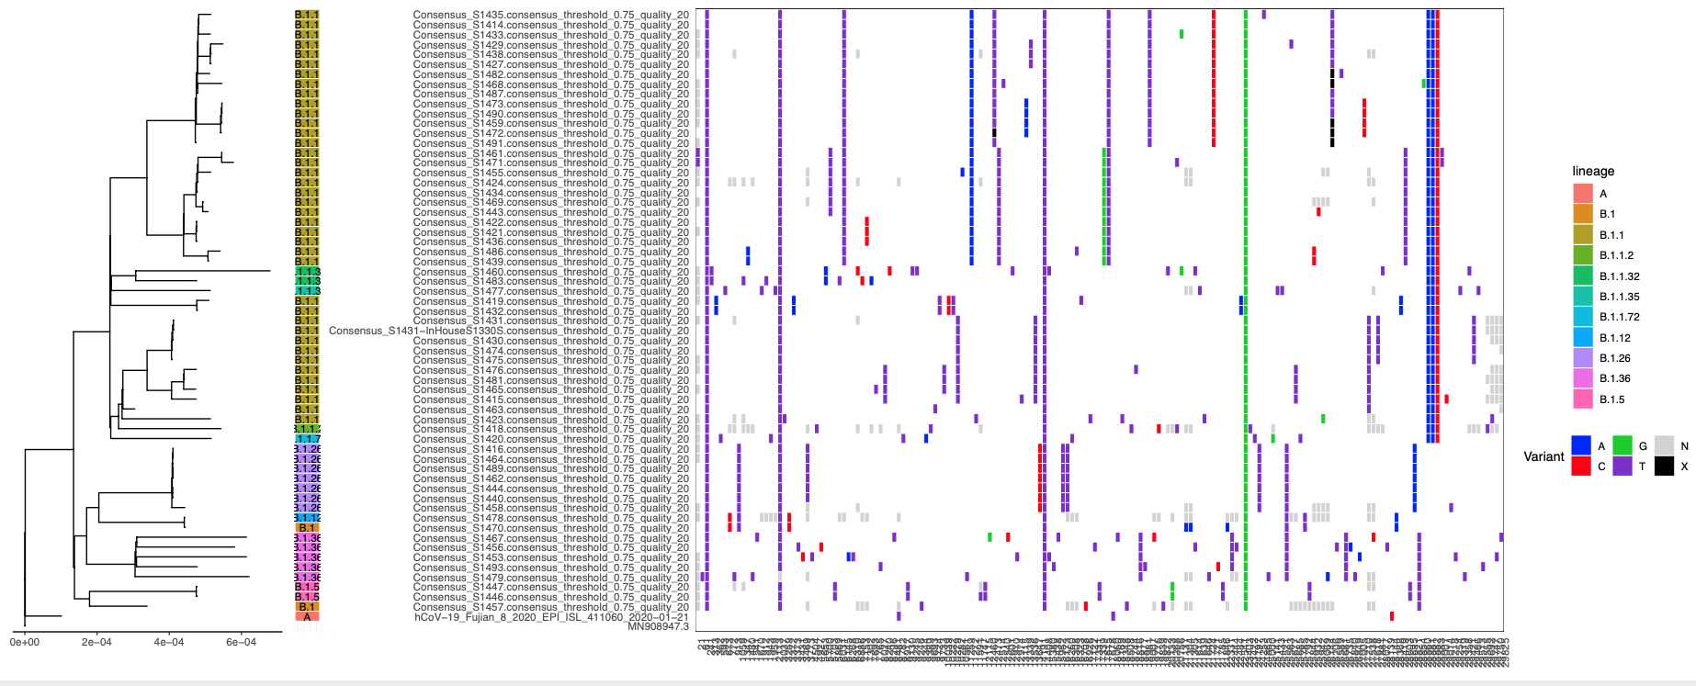
What is the risk for mutations?
~28,000 bp genome
Intrinsic mutation rate is low due to nonstructural protein 14 (nsp14): 3′-to-5′ exoribonuclease (ExoN) and guanine-N7-methyltransferase (N7-MTase) activities
Risk of diagnostic mutations low
Risk of mutations that change biological properties low – selective pressures?
Genome analysis must be intolerant of sequencing error!

Slide 23
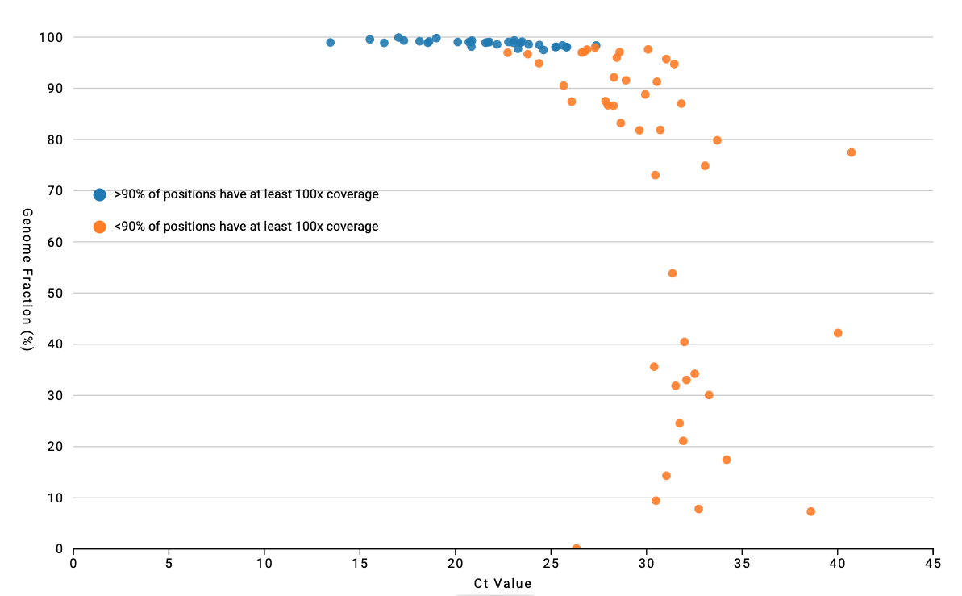
Problems with Sequencing Error

Slide 24
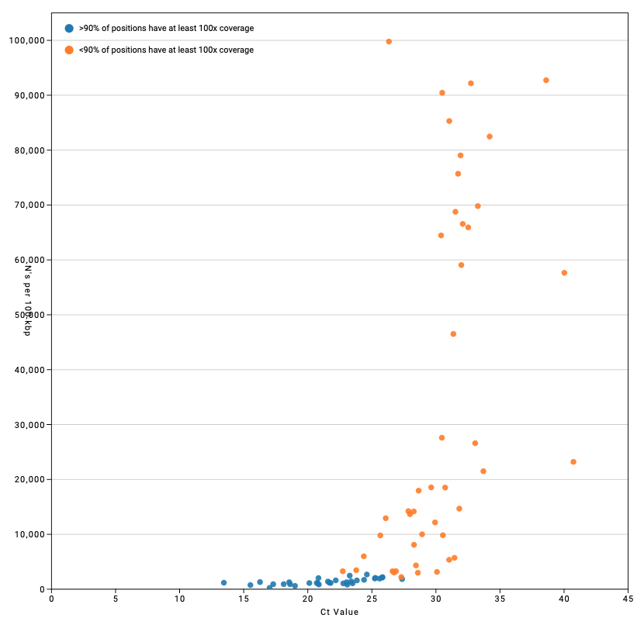
Problems with Sequencing Error

Slide 25
What is the risk for Escape Mutations? - 1st Wave
Population Biology
What is the intrinsic mutation rate low
How much time has passed, i.e., generations of replication not much
How big is the population, i.e., how many have been infected? 33M+
Is the population expanding or contracting? Bottlenecks? varies
Potential for recombination? needs assessment
Selective pressures? D614G
increased thermostability*
* Long et al. 2020. medRxiv 2020.09.22.20199125.

Slide 26
What is the risk for Escape Mutations? - 2nd, 3rd , 4th Waves
Population Biology
What is the intrinsic mutation rate low
How much time has passed, i.e., generations of replication > 1.5 years
How big is the population, i.e., how many have been infected? 262M+
Is the population expanding or contracting? Bottlenecks? regional waves
Potential for recombination? Minimal
Selective pressures? new mutations
re-infection
increased transmission
convalescent serum
superior ACE2 binding
vaccination escape?

Slide 27
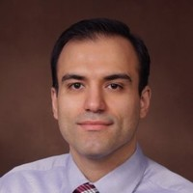
How do we sequence SARS-CoV-2?
Patryk Aftanas
(Sunnybrook)
Mike Surette
Hooman Derakhshani
(PDF, McMaster)

Slide 28
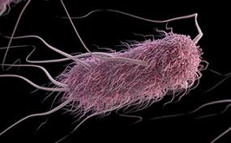
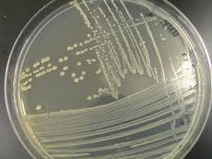
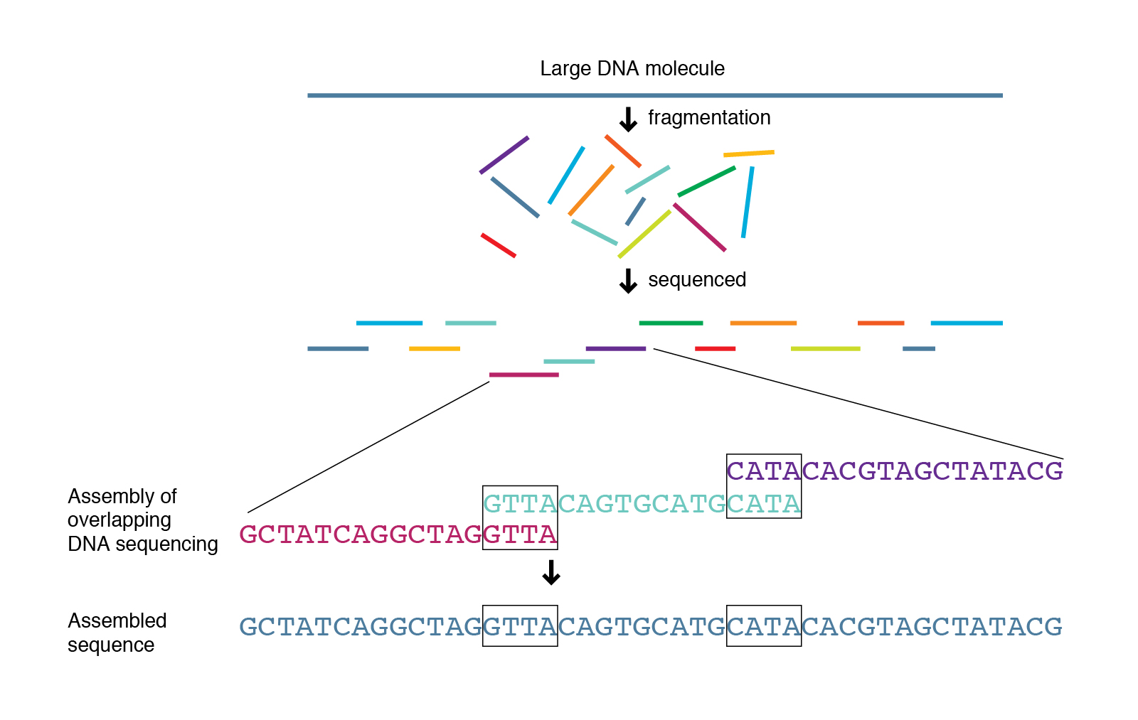
How do we sequence SARS-CoV-2?
E. coli
Culture to obtain large amount of clean DNA of pathogen
Random fragmentation of DNA – each part of the genome is equally sampled
Graph based computational assembly of the consensus genome
Highly redundant sequencing of each nucleotide; at least 100x
Sequencing error is nearly random; overcome by redundancy

Slide 29
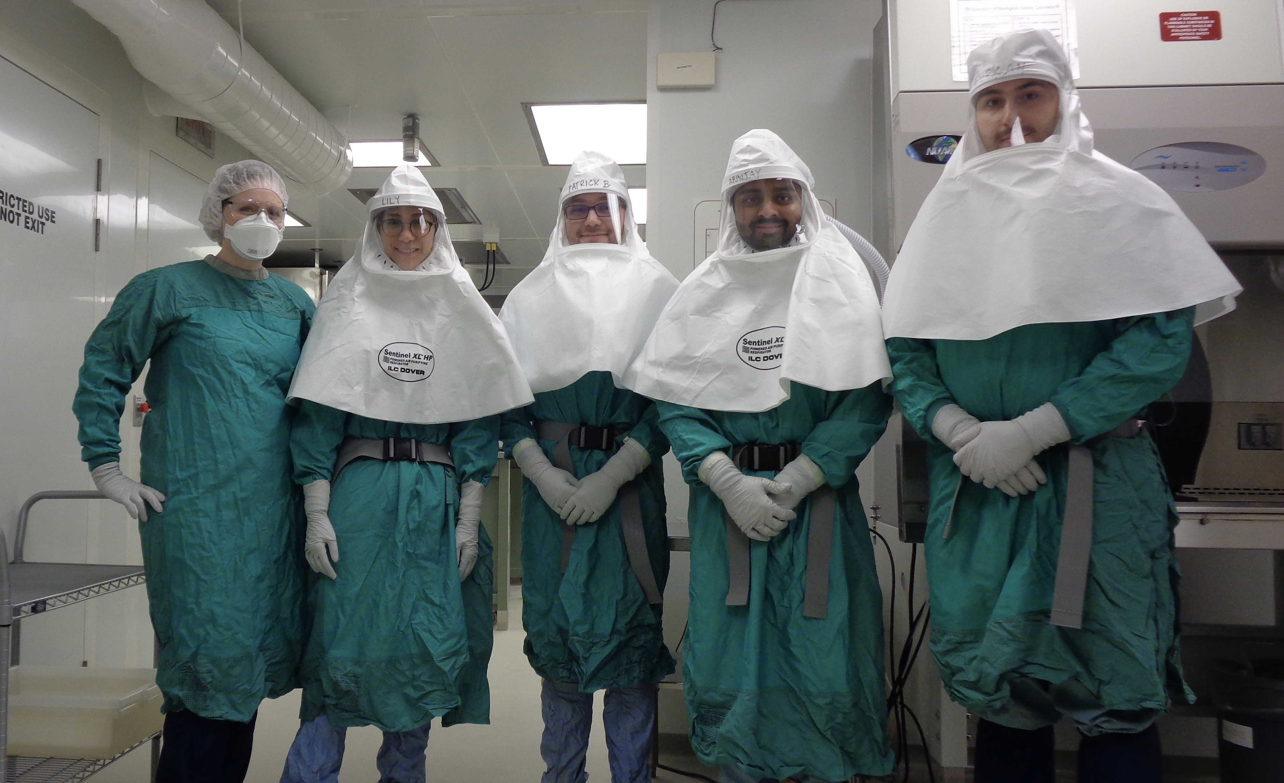
How do we sequence SARS-CoV-2?
BSL3
Arinjay Banerjee and friends

Slide 30
How do we sequence SARS-CoV-2?
cDNA
reverse transcriptase
Overlapping PCR Amplicons → Illumina Sequencing
Liverpool – 30 amplicons
ARTIC3 – 98 amplicons

Slide 31
How do we sequence SARS-CoV-2?
cDNA
reverse transcriptase
Overlapping PCR Amplicons → Illumina Sequencing
Culture to obtain large amount of clean DNA of pathogen
Random fragmentation of DNA – each part of the genome is equally sampled
Graph based computational assembly of the consensus genome
Highly redundant sequencing of each nucleotide; at least 100x
Sequencing error is nearly random; overcome by redundancy
Liverpool – 30 amplicons
ARTIC3 – 98 amplicons

Slide 32
How do we sequence SARS-CoV-2?
cDNA
reverse transcriptase
Overlapping PCR Amplicons → Illumina Sequencing
Patient DNA!
Culture to obtain large amount of clean DNA of pathogen
Random fragmentation of DNA – each part of the genome is equally sampled
Graph based computational assembly of the consensus genome
Highly redundant sequencing of each nucleotide; at least 100x
Sequencing error is nearly random; overcome by redundancy
Liverpool – 30 amplicons
ARTIC3 – 98 amplicons

Slide 33
How do we sequence SARS-CoV-2?
cDNA
reverse transcriptase
Overlapping PCR Amplicons → Illumina Sequencing
Patient DNA!
Culture to obtain large amount of clean DNA of pathogen
Random fragmentation of DNA – each part of the genome is equally sampled
Graph based computational assembly of the consensus genome
Highly redundant sequencing of each nucleotide; at least 100x
Sequencing error is nearly random; overcome by redundancy
Liverpool – 30 amplicons
ARTIC3 – 98 amplicons

Slide 34
How do we sequence SARS-CoV-2?
cDNA
reverse transcriptase
Overlapping PCR Amplicons → Illumina Sequencing
Patient DNA!
Culture to obtain large amount of clean DNA of pathogen
Random fragmentation of DNA – each part of the genome is equally sampled
Graph based computational assembly of the consensus genome
Highly redundant sequencing of each nucleotide; at least 100x
Sequencing error is nearly random; overcome by redundancy
10x coverage
Liverpool – 30 amplicons
ARTIC3 – 98 amplicons

Slide 35
How do we sequence SARS-CoV-2?
cDNA
reverse transcriptase
Overlapping PCR Amplicons → Illumina Sequencing
Patient DNA!
Culture to obtain large amount of clean DNA of pathogen
Random fragmentation of DNA – each part of the genome is equally sampled
Graph based computational assembly of the consensus genome
Highly redundant sequencing of each nucleotide; at least 100x
Sequencing error is nearly random; overcome by redundancy
10x coverage
Liverpool – 30 amplicons
ARTIC3 – 98 amplicons

Slide 37
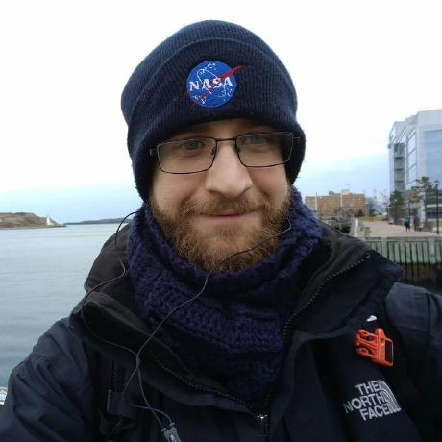
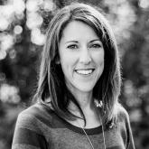

SIGNAL: SARS-CoV-2 Illumina GeNome Assembly Line
https://github.com/jaleezyy/covid-19-signal
J.A. Nasir
R.A. Kozak
P. Aftanas
A.R. Raphenya
K.M. Smith
F. Maguire
H. Maan
M. Alruwaili
A. Banerjee
H. Mbareche
B.P. Alcock
N.C. Knox
K. Mossman
B. Wang
J.A. Hiscox
A.G. McArthur
S. Mubareka
Jalees Nasir
Amos Raphenya
Kendrick Smith (Perimeter Institute)
Finlay Maguire (Dalhousie)
Natalie Knox (PHAC)
Nasir et al. 2020. Viruses, 12, 895.

Slide 38
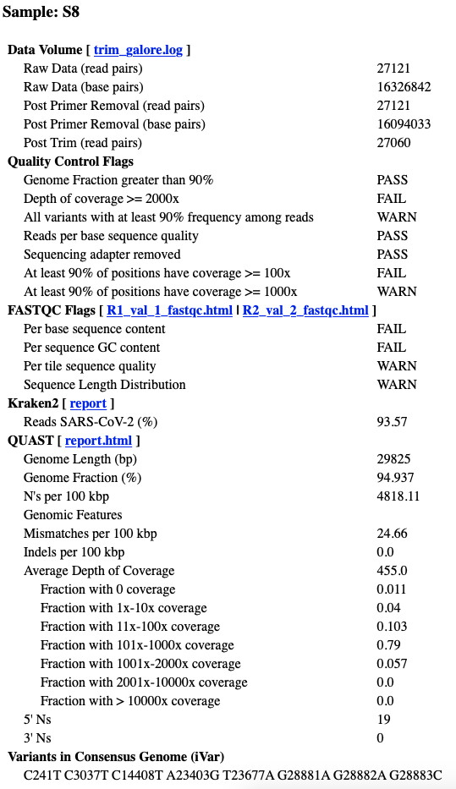
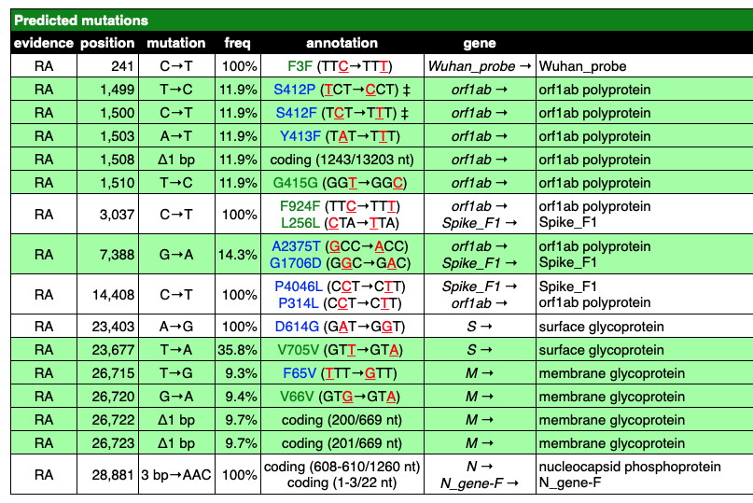
SIGNAL: SARS-CoV-2 Illumina GeNome Assembly Line
https://github.com/jaleezyy/covid-19-signal
J.A. Nasir
R.A. Kozak
P. Aftanas
A.R. Raphenya
K.M. Smith
F. Maguire
H. Maan
M. Alruwaili
A. Banerjee
H. Mbareche
B.P. Alcock
N.C. Knox
K. Mossman
B. Wang
J.A. Hiscox
A.G. McArthur
S. Mubareka
Jalees Nasir
Amos Raphenya
Nasir et al. 2020. Viruses, 12, 895.

Slide 39
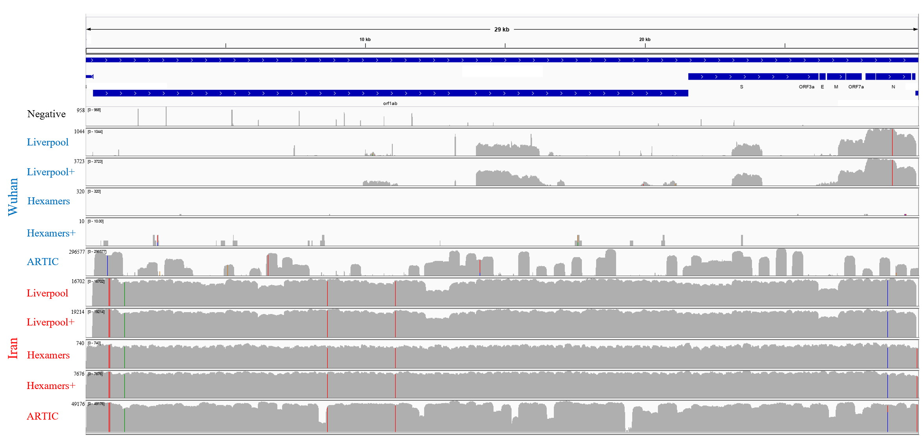
SIGNAL: SARS-CoV-2 Illumina GeNome Assembly Line
https://github.com/jaleezyy/covid-19-signal
Viral concentration (Ct value) is the most important predictor of success
ARTIC3 provides highest depth of coverage of the SARS-CoV-2 genome; but dropped amplicons
LIVERPOOL provides the most even coverage of the SARS-CoV-2 genome
Bait capture enrichment provides results on par with sequencing amplicons
Bait capture very useful for determining PCR artifacts
Nasir et al. 2020. Viruses, 12, 895.

Slide 40


NCoV-Tools: Quality control for SARS-CoV-2 sequencing
https://github.com/jts/ncov-tools
Jared Simpson (OICR)

Slide 41

CanCOGeN

Slide 42



CanCOGeN
Amos Raphenya
Andrew McArthur
Ahmed Draia
Emily Panousis
Mike Surette
Hooman Derakhshani

Slide 43

Ahmed Draia
Emily Panousis

Slide 44
McMaster – Sunnybrook
4,837 genomes sequenced
2,148 in GISAID (713 pending)
- current success rate >90%
- often 6 days from swab to GISAID, sometimes <4 days
Until recent retrospective data dumps… (late 2020)
~20% of national data
~50% of Ontario data
Currently… (late 2021)
~1-2% of national data
~6.3% of Ontario data
Hamilton Public Health Ontario overflow
London Dynacare
Ottawa Pearson Airport
Toronto (Sunnybrook & Mt. Sinai) Institutional Outbreaks
Brampton / Etobicoke - Hamilton General
Windsor - Juravinski
North Bay & Sudbury via Canadore College
Notes:
Early on, much of the Canadian sequencing data, especially for that of Ontario was dominated by our work as systems were being put in place and through our collaborations with Sunnybrook
Databases like the Global Initiative on Sharing Avian Influenza Data or GISAID became the main internationally recognized site to submit SARS-CoV-2 genome sequences and we continue to submit there even now.
As Public Health Ontario started to become a more centralized unit, we also see many other provinces submitting sequence data to GISAID around the turn of 2021.
Overall, much of the data processed through SIGNAL make up about 1-2% of all Canadian sequences and 6.3% of Ontario’s sequences.

Slide 46


The First Wave in Canada
Finlay Maguire (Dalhousie)

Slide 47

What do we know for Hamilton/Ontario?
June 2020 – LTC & Hospital Outbreak B.1.1 * no community data
November 2020 – Point Prevalence (80 positives) 19 different variants (5 predominant)
December 2020 – Juravinski Outbreak B.1.564.1 + 7 other variants
January 2021 – PHO Point Prevalence ~77% samples confirmed B.1.1.7
February 2021 – Vulnerable Community Outbreak R.1 + 3 other variants

Slide 48


November 24, 2020 ‘Point Prevalence’

Slide 49
November 24, 2020 ‘Point Prevalence’
Early warning! Zeta variant (VUI)

Slide 50



Ontario SARS-CoV-2 Point Prevalence Study – January 2021
2,570 samples received and screened for N501Y
4.4% of screened samples had N501Y mutation
~77% of samples positive for N501Y were confirmed to be Alpha (B.1.1.7) Variants by WGS
~3,003 SARS-CoV-2 samples were reported in Ontario on January 20th 2021
80.5% of these were from the Simcoe Muskoka District Health Unit
PANGO Lineage detection
https://www.publichealthontario.ca/-/media/documents/ncov/voc/2021/02/sars-cov-2-variants-point-prevalence.pdf
Slide adapted from Emily Panousis

Slide 51
Canada’s Third Wave & Variants of Concern
Alpha (B.1.1.7) 32 defining mutations 8 spike mutations ~50% incr. transmissibility
30-70% incr. mortality
50:50 male:female ratio
Beta (B.1.351) 21 defining mutations 9 spike mutations likely incr. transmissibility
Gamma (P.1) 17 defining mutations 10 spike mutations incr. transmissibility?

Slide 52
Canada’s Third Wave & Variants of Concern
Alpha (B.1.1.7) Novavax trial reports reduction in vaccine efficacy; origins in immunocompromised patient?
Beta (B.1.351) partial resistance in two randomized control trials (RCTs)
Gamma (P.1) unclear but associated with re-infection

Slide 53

Canada’s Third Wave & Variants of Concern
Alpha (B.1.1.7) H69-/V70- N501Y
Beta (B.1.351) N501Y
Gamma (P.1) N501Y
May increase ACE2 binding; ACE2 binding may be further increased by the presence of E484K; stabilized by the presence of K417N
May be associated with adaptation to rodents and mustelids (i.e. mink); animal reservoir?
Small but significant reduction in neutralization via Moderna and Pfizer-BioNTech vaccines.

Slide 54

Canada’s Third Wave & Variants of Concern
Alpha (B.1.1.7) H69-/V70- N501Y
Beta (B.1.351) N501Y E484K
Gamma (P.1) N501Y E484K
receptor binding domain
may increase ACE2 binding, which may be further increased by the presence of S:N501Y, and stabilized by the presence of S:K417N
may significantly reduce convalescent serum neutralization
associated with re-infection
tests in people vaccinated with the Moderna and Pfizer-BioNTech vaccines suggest S:E484K and S:N501Y individually, and both together in combination with S:K417N, cause a small but significant reduction in neutralization

Slide 55
Canada’s Third Wave & Variants of Concern
Alpha (B.1.1.7) H69-/V70- N501Y P681H
Beta (B.1.351) N501Y E484K
furin cleavage site
Gamma (P.1) N501Y E484K
receptor binding domain
directly adjacent to the SARS-CoV-2 S1/S2 furin cleavage site
may increase cleavability and membrane fusion to enhance infectivity

Slide 56
Canada’s Third Wave & Variants of Concern
Alpha (B.1.1.7) H69-/V70- N501Y E484K P681H
Beta (B.1.351) N501Y E484K
furin cleavage site
Gamma (P.1) N501Y E484K
receptor binding domain

Slide 57

Canada’s Third Wave & Variants of Concern
Alpha (B.1.1.7) H69-/V70- N501Y E484K P681H
Beta (B.1.351) N501Y E484K
furin cleavage site
Gamma (P.1) N501Y E484K
receptor binding domain

Slide 58


Canada’s Third Fourth Wave & Variants of Concern
Spike: T19R, 156del, 157del, R158G, L452R, T478K, D614G, P681R, D950N
B.1.617.2 (Delta) VOC lacking N501Y or E484K

Slide 60





Hamilton R.1 Outbreak
January/February 2021 - Burden fell on a community experiencing homelessness
E484K, G769V and W152L Mutations
R.1 idenified in a shelter outbreak in Hamilton
Culturing of R.1 Variant
"Escape mutations" that pose a threat to our current diagnostic methods
Implications in determining functional ability of this variant
Localized outbreak, spread limited in rest of the city
Slide adapted from Emily Panousis

Slide 61





The game plan: genomic surveillance teamwork
Samples collected and sequenced by HHS
Raw Data sent to McArthur Lab Weekly
Consensus genomes run through SIGNAL and PANGOLIN
PANGO Lineage Reports Generated
Slide adapted from Emily Panousis

Slide 62

Weekly lineage reports helped Hamilton be reclassified as a Delta hotspot

Slide 63


Delta Variant in Hamilton: Summer 2021
100%
Hamilton named a "Delta Hotspot"
75%
Proportion of samples from weekly HHS batch assigned as Delta
50%
25%
0%
June 10th
June 16th June 22nd
Date of SIGNAL Run
July 30th
August 31st
Slide adapted from Emily Panousis

Slide 64
Thanks!
McArthur Lab
Amos Raphenya, Emily Panousis, Ahmed Draia, Dr. McArthur
McMaster
Mike Surette, Hooman Derakhshani, Arinjay Banerjee, Farncombe Sequencing Team, MILO, CSU, HiREB, Gina Mannen, Gerry Wright, Karen Mossman
ONCoV, ONS2, Sunnybrook
Jared Simpson, Samira Mubareka, Rob Kozak, Robyn Lee, Ramzi Fattouh, Hamza Mbareche, Kyuganya Nirmalarajah, Patryk Aftanas , and so many more…
CanCOGeN
Gary Van Domselaar, Natalie Knox, and the many working groups (QC & BC especially!)
The ‘Hackers’
Finlay Maguire, Kendrick Smith, Hassaan Maan, Bo Wang, DNAStack

Slide 65






Thanks!

Slide 66
End

